Slide 1
Teachings for
Exercise 13E

Slide 2
Integration
$$x+δx,f(x+δx)$$
Definite integration can be used to find areas under curves
We are trying to find a formula for the area between a curve and the x-axis, up to a value of x which has been decided
On the graph to the right, let A be the area between the curve and the x-axis, up to a value x.
If we add a small increase to x, it will add a small increase to the area
We can write expressions for the coordinates on the line
The increase in area will be somewhere between the areas of two different rectangles, as shown…
$$x,f(x)$$
$$y=f(x)$$
$$f(x)$$
$$δA$$
$$f(x+δx)$$
$$A$$
$$x$$
$$x+δx$$
$$δx$$
$$δA≥f(x)×δx$$
$$δA≤f(x+δx)×δx$$
$$f(x)×δx≤δA≤f(x+δx)×δx$$
$$f(x)δx≤δA≤f(x+δx)δx$$
13E

Slide 3
Integration
$$x+δx,f(x+δx)$$
Definite integration can be used to find areas under curves
So now we have established that the area is somewhere in the interval below, which can be manipulated.
$$x,f(x)$$
$$y=f(x)$$
$$δA$$
$$A$$
$$f\left(x\right)δx≤δA≤f(x+δx)δx$$
$$x$$
$$x+δx$$
Divide by $δx$
$$\frac{δA}{δx}$$
$$f(x+δx)$$
$$f\left(x\right)$$
$$≤$$
$$≤$$
As$δx→0$, the notation changes to $d$ (to indicate that tending to 0 has happened)
$$\frac{dA}{dx}$$
$$f(x)$$
$$f\left(x\right)$$
$$≤$$
$$≤$$
There is only one logical conclusion here…
$$\frac{dA}{dx}=f(x)$$
If we differentiate $A$ with respect to x, we would get $\frac{dA}{dx}$.
→ Therefore, if we integrate $\frac{dA}{dx}$ with respect to x, we get $A$, since differentiating and integrating are opposite actions
Integrate both sides with respect to $x$
$$A=\int{f(x)} dx$$
13E

Slide 4
Integration
Definite integration can be used to find areas under curves
So far we have shown that the area between a curve and the x-axis is based on integrating the function:
However, there is a small issue.
The area could be infinite, depending on the shape of the curve.
The only way we can calculate a specific value is to find the difference between the answers for two values of x, as shown…
$$y=f(x)$$
$$A$$
$$A$$
$$A=\int{f(x)} dx$$
$$x_{2}$$
$$x$$
13E

Slide 5
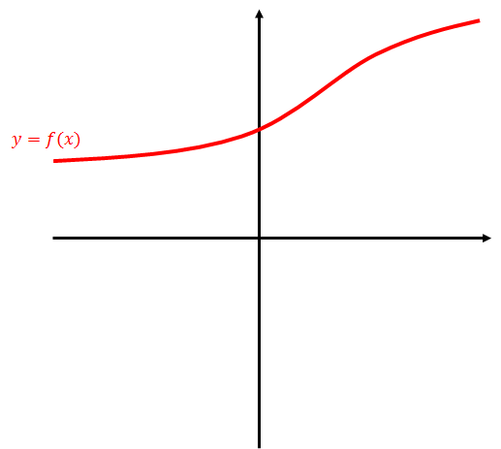
Integration
Definite integration can be used to find areas under curves
So far we have shown that the area between a curve and the x-axis is based on integrating the function:
$$y=f(x)$$
$$A$$
$$A=\int{f(x)} dx$$
$$a$$
$$b$$
The letters a and b are usually used to represent the values for x at each point…
$$=$$
$$−$$
The area between two limits is given when we take the value gained when integrating and substituting b, and subtract the value gained when subtracting a
13E

Slide 6
Integration
Definite integration can be used to find areas under curves
So far we have shown that the area between a curve and the x-axis is based on integrating the function:
The area between two limits, $a$ and $b$, is given by:
$$y=f(x)$$
$$A$$
$$A=\int{f(x)} dx$$
$$a$$
$$b$$
$$A=\int_{a}^{b}{f\left(x\right) dx}$$
13E

Slide 7
Integration
20
Definite integration can be used to find areas under curves
Find the area of the finite region between the curve with equation $y=20−x−x^{2}$ and the x-axis.
Often a sketch of the graph can help with this kind of question
Find the roots, and the y-intercept (if needed – often in these questions it is not necessary)
$$A=\int_{a}^{b}{f\left(x\right) dx}$$
-5
4
$$A=\int_{−5}^{4}{\left(20−x−x^{2}\right) dx}$$
Integrate and use a square bracket
Sub in limits and subtract
$$={\left[20x−\frac{x^{2}}{2}−\frac{x^{3}}{3}\right]}_{−5}^{4}$$
$$=\left(20(4)−\frac{{(4)}^{2}}{2}−\frac{{(4)}^{3}}{3}\right)−\left(20(−5)−\frac{{(−5)}^{2}}{2}−\frac{{(−5)}^{3}}{3}\right)$$
$$=\frac{243}{2}$$
Calculate
13E

Slide 8
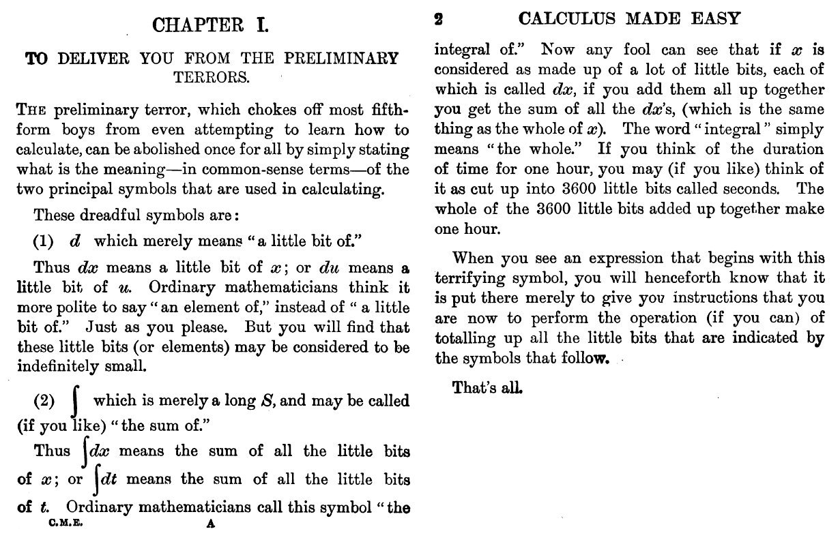
Integration
Definite integration can be used to find areas under curves
13E

