Slide 1
Teachings for
Exercise 13D

Slide 2




Integration
You can calculate the value of an integral between two limits. This is called a definite integral.
An indefinite integral gives you a function, whereas a definite integral gives you a final value
In this section you will see how to calculate a definite integral
Next lesson you will see what this is for!
$$Find: \int_{1}^{2}{{3x}^{2}} dx$$
Integrate the function and write using a squared bracket
$${=\left[x^{3}\right]}_{1}^{2}$$
Substitute 2 and 1 into the function separately, and subtract
$$= {\left(2\right)}^{3}−{\left(1\right)}^{3}$$
Calculate
$$=7$$
Note that when calculating a definite integral, you do not need to include c!
→ If you did, you would only end up with c – c in the 3rd stage above…
13D

Slide 3
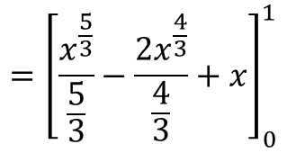

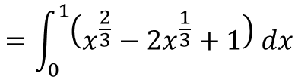


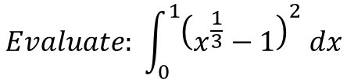




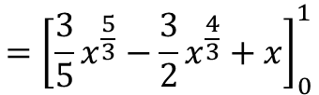
Integration
You can calculate the value of an integral between two limits. This is called a definite integral.
So the three steps are:
$$Evaluate: \int_{0}^{1}{{\left(x^{\frac{1}{3}}−1\right)}^{2} dx}$$
Square the bracket (keep the integral notation)
$$=\int_{0}^{1}{\left(x^{\frac{2}{3}}−2x^{\frac{1}{3}}+1\right) dx}$$
Integrate and write using squared brackets
$$={\left[\frac{x^{\frac{5}{3}}}{\frac{5}{3}}−\frac{{2x}^{\frac{4}{3}}}{\frac{4}{3}}+x\right]}_{0}^{1}$$
1) Write the integral with its limits
$$\int_{a}^{b}{……dx}$$
Rewrite
2) Integrate the function and write using square brackets
$$={\left[{\frac{3}{5}x}^{\frac{5}{3}}−{\frac{3}{2}x}^{\frac{4}{3}}+x\right]}_{0}^{1}$$
$${\left[……\right]}_{a}^{b}$$
Sub in 1 and 0
$$=$$
$$\left({\frac{3}{5}(1)}^{\frac{5}{3}}−{\frac{3}{2}\left(1\right)}^{\frac{4}{3}}+(1)\right)−\left({\frac{3}{5}(0)}^{\frac{5}{3}}−{\frac{3}{2}\left(0\right)}^{\frac{4}{3}}+(0)\right)$$
3) Evaluate the definite integral by calculating $f\left(b\right)−f(a)$
$$\left(…\right)−(…)$$
Calculate
$$=\frac{1}{10}$$
13D

Slide 4

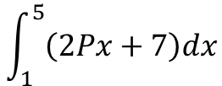


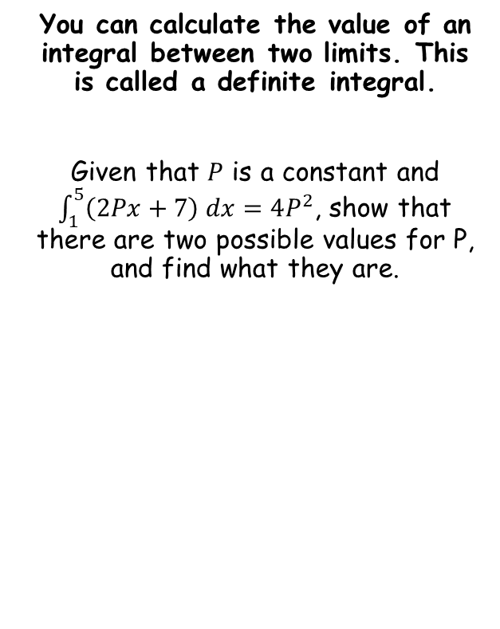



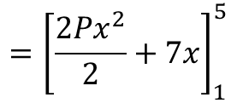

Integration
$$\int_{1}^{5}{\left(2Px+7\right)dx}$$
You can calculate the value of an integral between two limits. This is called a definite integral.
Given that $P$ is a constant and $\int_{1}^{5}{\left(2Px+7\right) dx}=4P^{2}$, show that there are two possible values for P, and find what they are.
Integrate and use a squared bracket
$$={\left[\frac{2Px^{2}}{2}+7x\right]}_{1}^{5}$$
Simplify
$$={\left[Px^{2}+7x\right]}_{1}^{5}$$
Sub in the values and subtract
$$=\left(P{\left(5\right)}^{2}+7\left(5\right)\right)−\left(P{\left(1\right)}^{2}+7\left(1\right)\right)$$
Simplify
$$=24P+28$$
$$4P^{2}=24P+28$$
Rearrange
$$4P^{2}−24P−28=0$$
Divide by 4
$$P^{2}−6P−7=0$$
Factorise
$$\left(P+1\right)\left(P−7\right)=0$$
Calculate answers
$$P=−1 or 7$$
13D

