Slide 1
Teachings for
Exercise 12D

Slide 2

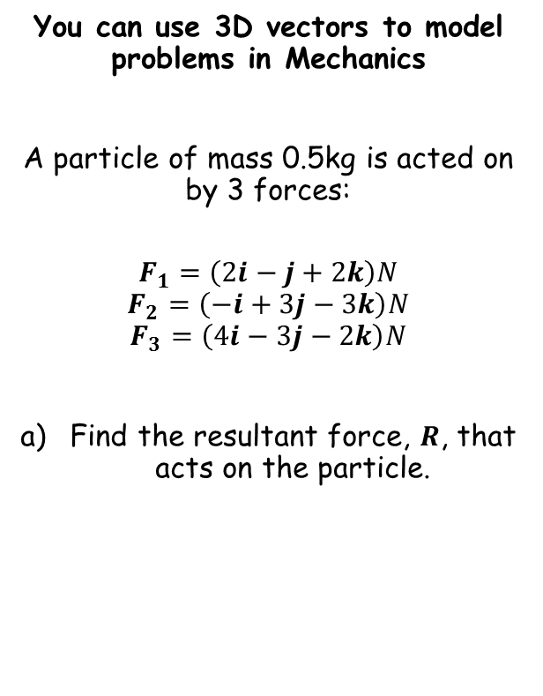


Vectors
Replace the forces
You can use 3D vectors to model problems in Mechanics
A particle of mass 0.5kg is acted on by 3 forces:
$$F_{1}=\left(2i−j+2k\right)N$$
$$F_{2}=\left(−i+3j−3k\right)N$$
$$F_{3}=\left(4i−3j−2k\right)N$$
Find the resultant force, $R$, that acts on the particle.
$$R=F_{1}+F_{2}+F_{3}$$
$$R=\left(2i−j+2k\right)+\left(−i+3j−3k\right)+\left(4i−3j−2k\right)$$
$$R=\left(5i−j−3k\right)N$$
Calculate
$$R=\left(5i−j−3k\right)N$$
12D

Slide 3
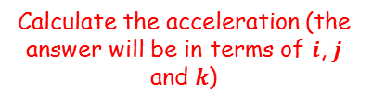

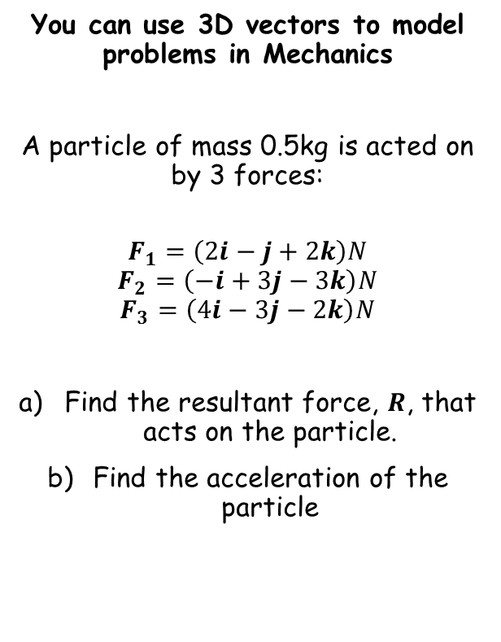



Vectors
You can use 3D vectors to model problems in Mechanics
A particle of mass 0.5kg is acted on by 3 forces:
$$F_{1}=\left(2i−j+2k\right)N$$
$$F_{2}=\left(−i+3j−3k\right)N$$
$$F_{3}=\left(4i−3j−2k\right)N$$
Find the resultant force, $R$, that acts on the particle.
Find the acceleration of the particle
$$F=ma$$
Sub in the resultant force and the mass
$$\left(5i−j−3k\right)=0.5a$$
Calculate the acceleration (the answer will be in terms of $i$, $j$ and $k$)
$$\left(10i−2j−6k\right)=a$$
$$R=\left(5i−j−3k\right)N$$
$$a=\left(10i−2j−6k\right) {ms}^{−2}$$
12D

Slide 4
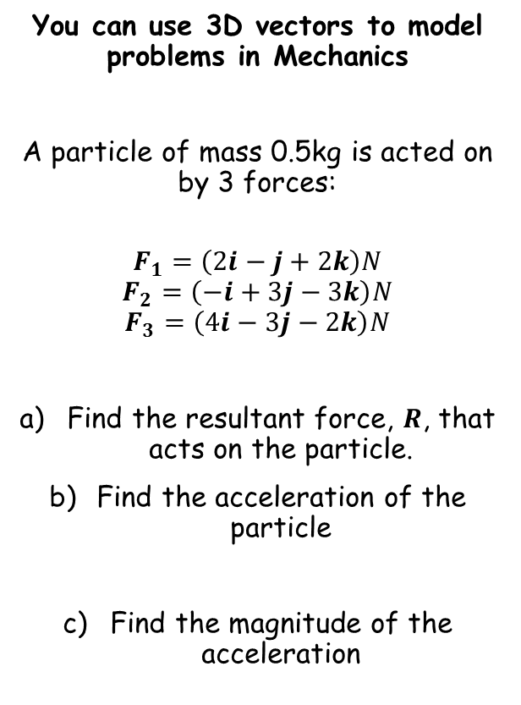


Vectors
You can use 3D vectors to model problems in Mechanics
A particle of mass 0.5kg is acted on by 3 forces:
$$F_{1}=\left(2i−j+2k\right)N$$
$$F_{2}=\left(−i+3j−3k\right)N$$
$$F_{3}=\left(4i−3j−2k\right)N$$
Find the resultant force, $R$, that acts on the particle.
Find the acceleration of the particle
Find the magnitude of the acceleration
$$\left|a\right|=\sqrt{{(10)}^{2}+{(−2)}^{2}+{(−6)}^{2}}$$
Calculate
$$\left|a\right|=\sqrt{140} {ms}^{−2}$$
$$R=\left(5i−j−3k\right)N$$
$$a=\left(10i−2j−6k\right) {ms}^{−2}$$
12D

Slide 5




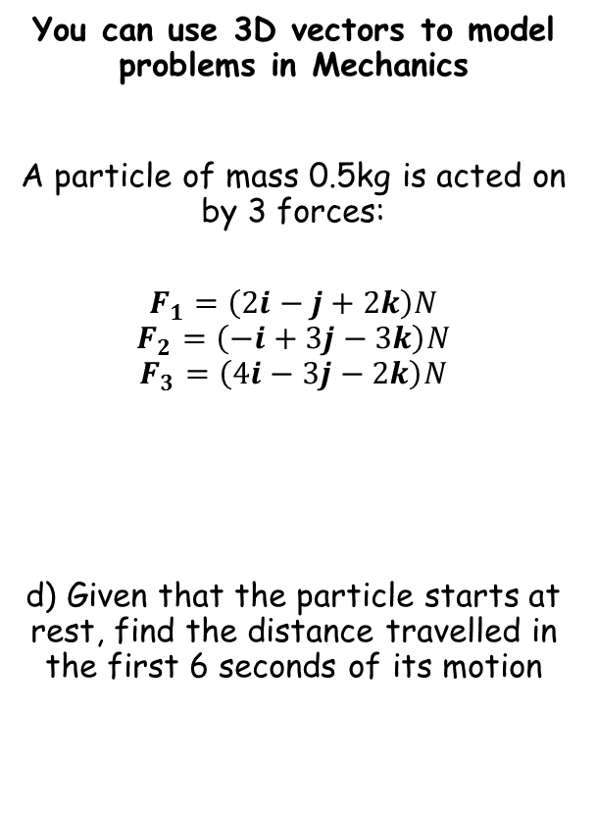






Vectors
$$s= ?$$
$$u=0$$
$$v= ?$$
$$a=\sqrt{140}$$
$$t=6$$
You can use 3D vectors to model problems in Mechanics
A particle of mass 0.5kg is acted on by 3 forces:
$$F_{1}=\left(2i−j+2k\right)N$$
$$F_{2}=\left(−i+3j−3k\right)N$$
$$F_{3}=\left(4i−3j−2k\right)N$$
d) Given that the particle starts at rest, find the distance travelled in the first 6 seconds of its motion
$$s=ut+\frac{1}{2}at^{2}$$
Sub in values
$$s=(0)(6)+\frac{1}{2}\sqrt{140}{(6)}^{2}$$
Calculate
$$s=36\sqrt{35} m$$
$$R=\left(5i−j−3k\right)N$$
$$a=\left(10i−2j−6k\right) {ms}^{−2}$$
$$\left|a\right|=\sqrt{140} {ms}^{−2}$$
12D

