Slide 1
Applications to mechanics (12.4)

Slide 2
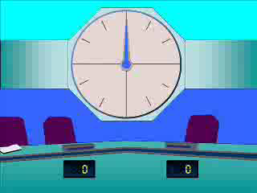
1
A particle is acted on by three forces
$F_{1}=\left(8i−3j+6k\right)N$ and
$F_{2}=\left(−6i+9j+4k\right)N$.
Find the resultant force.
a) $\left(14i−12j+2k\right)N$
b) $\left(\sqrt{140}\right)N$
c) $\left(2i+6j+10k\right)N$
d) $\left(2i+6j+2k\right)N$

Slide 3
2
A particle is acted on by three forces
$F_{1}=\left(−5i+3j+k\right)N$, $F_{2}=\left(2i−5k\right)N$
and $F_{3}=\left(−4j+3k\right)N$. Find the resultant
force.
a) $\left(−3i+7j+3k\right)N$
b) $\left(−3i−j−k\right)N$
c) $\left(−3i−6j+4k\right)N$
d) $\left(−9i+3j−k\right)N$

Slide 4
3
Given that a force of $\left(5i−6j+12k\right)N$ acts
on a particle of 4kg, find the acceleration of
the particle.
a) $\left(\frac{5}{4}i−\frac{3}{2}j+3k\right)$
b) $\left(20i−24j+48k\right)$
c) $\sqrt{205}$
d) $\frac{\sqrt{205}}{4}$

