Slide 1
Teachings for
Exercise 12B

Slide 2



Vectors
You need to be able to use vectors to describe movement in 3 dimensions
You can use 3D vectors to describe movement in 3 dimensions
$$k=\left(\begin{matrix}0 \\ 0 \\ 1\end{matrix}\right)$$
A movement one unit in the z-direction
$$i=\left(\begin{matrix}1 \\ 0 \\ 0\end{matrix}\right)$$
z
A movement one unit in the x-direction
$$j=\left(\begin{matrix}0 \\ 1 \\ 0\end{matrix}\right)$$
A movement one unit in the y-direction
y
x
12B

Slide 3

Vectors
You need to be able to use vectors to describe movement in 3 dimensions
You can use 3D vectors to describe movement in 3 dimensions
z
For any vector in 3 dimensions:
$$pi+qj+rk=\left(\begin{matrix}p \\ q \\ r\end{matrix}\right)$$
y
x
12B

Slide 4

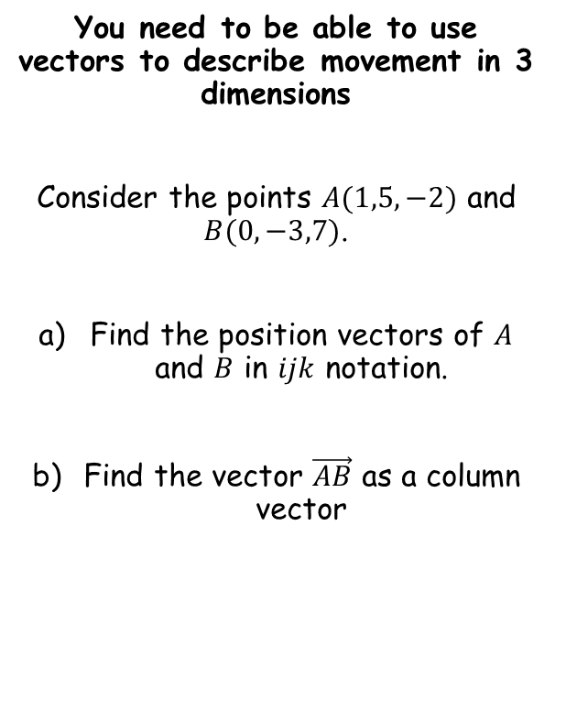

Vectors
You need to be able to use vectors to describe movement in 3 dimensions
Consider the points $A(1,5,−2)$ and $B(0,−3,7)$.
Find the position vectors of $A$ and $B$ in $ijk$ notation.
Find the vector $\vec{AB}$ as a column vector
The position vector of a point is the vector to get to it from (0,0,0)
$$\vec{OA}=i+5j−2k$$
$$\vec{OB}=−3j+7k$$
12B

Slide 5

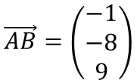
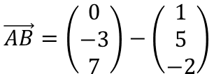


Vectors
You need to be able to use vectors to describe movement in 3 dimensions
Consider the points $A(1,5,−2)$ and $B(0,−3,7)$.
Find the position vectors of $A$ and $B$ in $ijk$ notation.
Find the vector $\vec{AB}$ as a column vector
$$\vec{AB}=\vec{OB}−\vec{OA}$$
Sub in the vectors we have as columns
$$\vec{AB}=\left(\begin{matrix}0 \\ −3 \\ 7\end{matrix}\right)−\left(\begin{matrix}1 \\ 5 \\ −2\end{matrix}\right)$$
Calculate
$$\vec{AB}=\left(\begin{matrix}−1 \\ −8 \\ 9\end{matrix}\right)$$
$$\vec{OA}=i+5j−2k$$
$$\vec{OB}=−3j+7k$$
12B

Slide 6



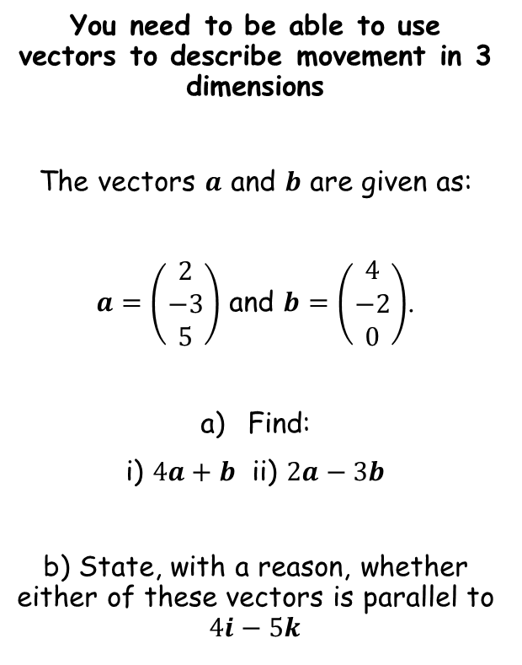
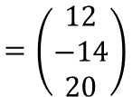
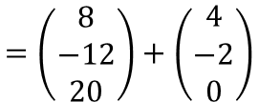
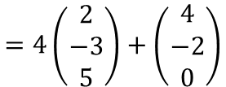
Vectors
You need to be able to use vectors to describe movement in 3 dimensions
The vectors $a$ and $b$ are given as:
$a=\left(\begin{matrix}2 \\ −3 \\ 5\end{matrix}\right)$ and $b=\left(\begin{matrix}4 \\ −2 \\ 0\end{matrix}\right)$.
Find:
i) $4a+b$ ii) $2a−3b$
b) State, with a reason, whether either of these vectors is parallel to $4i−5k$
$$4a+b$$
Sub in $a$ and $b$
$$=4\left(\begin{matrix}2 \\ −3 \\ 5\end{matrix}\right)+\left(\begin{matrix}4 \\ −2 \\ 0\end{matrix}\right)$$
Multiply the first by 4
$$=\left(\begin{matrix}8 \\ −12 \\ 20\end{matrix}\right)+\left(\begin{matrix}4 \\ −2 \\ 0\end{matrix}\right)$$
$$=\left(\begin{matrix}12 \\ −14 \\ 20\end{matrix}\right)$$
Add together
$$4a+b=\left(\begin{matrix}12 \\ −14 \\ 20\end{matrix}\right)$$
12B

Slide 7

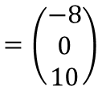
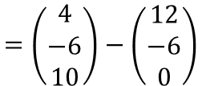
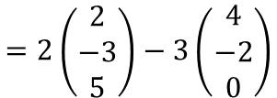

Vectors
You need to be able to use vectors to describe movement in 3 dimensions
The vectors $a$ and $b$ are given as:
$a=\left(\begin{matrix}2 \\ −3 \\ 5\end{matrix}\right)$ and $b=\left(\begin{matrix}4 \\ −2 \\ 0\end{matrix}\right)$.
Find:
i) $4a+b$ ii) $2a−3b$
b) State, with a reason, whether either of these vectors is parallel to $4i−5k$
$$2a−3b$$
Sub in $a$ and $b$
$$=2\left(\begin{matrix}2 \\ −3 \\ 5\end{matrix}\right)−3\left(\begin{matrix}4 \\ −2 \\ 0\end{matrix}\right)$$
Multiply the first by 2 and the second by 3
$$=\left(\begin{matrix}4 \\ −6 \\ 10\end{matrix}\right)−\left(\begin{matrix}12 \\ −6 \\ 0\end{matrix}\right)$$
$$=\left(\begin{matrix}−8 \\ 0 \\ 10\end{matrix}\right)$$
Add together
$$4a+b=\left(\begin{matrix}12 \\ −14 \\ 20\end{matrix}\right)$$
$$2a−3b=\left(\begin{matrix}−8 \\ 0 \\ 10\end{matrix}\right)$$
12B

Slide 8
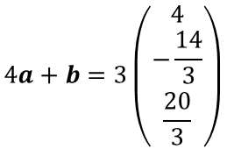
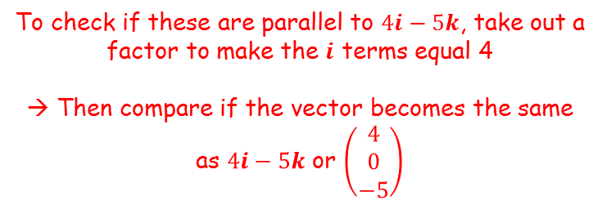




Vectors
To check if these are parallel to $4i−5k$, take out a factor to make the $i$ terms equal 4
→ Then compare if the vector becomes the same as $4i−5k$ or $\left(\begin{matrix}4 \\ 0 \\ −5\end{matrix}\right)$
You need to be able to use vectors to describe movement in 3 dimensions
The vectors $a$ and $b$ are given as:
$a=\left(\begin{matrix}2 \\ −3 \\ 5\end{matrix}\right)$ and $b=\left(\begin{matrix}4 \\ −2 \\ 0\end{matrix}\right)$.
Find:
i) $4a+b$ ii) $2a−3b$
b) State, with a reason, whether either of these vectors is parallel to $4i−5k$
$$4a+b=\left(\begin{matrix}12 \\ −14 \\ 20\end{matrix}\right)$$
$$2a−3b=\left(\begin{matrix}−8 \\ 0 \\ 10\end{matrix}\right)$$
$$4a+b=3\left(\begin{matrix}4 \\ −\frac{14}{3} \\ \frac{20}{3}\end{matrix}\right)$$
$$2a−3b=−2\left(\begin{matrix}4 \\ 0 \\ −5\end{matrix}\right)$$
So only this one is parallel to $4i−5k$
$$4a+b=\left(\begin{matrix}12 \\ −14 \\ 20\end{matrix}\right)$$
$$2a−3b=\left(\begin{matrix}−8 \\ 0 \\ 10\end{matrix}\right)$$
12B

Slide 9






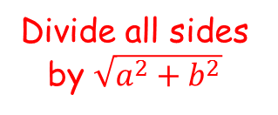

Vectors
Imagine we represent the vector $ai+bj$ (in 2 dimensions) using a right angled triangle, and calculate its magnitude
You need to be able to use vectors to describe movement in 3 dimensions
→ You also need to be able to calculate unit vectors…
$$\sqrt{a^{2}+b^{2}}$$
$$b$$
$$a$$
The second triangle is a unit vector (meaning it has a magnitude of 1), but in the same direction as the original vector…
So to find a unit vector parallel to another vector, divide all terms by the original vector’s magnitude…
This process also works in 3D!
Divide all sides by $\sqrt{a^{2}+b^{2}}$
$$1$$
$$\frac{b}{\sqrt{a^{2}+b^{2}}}$$
$$\frac{a}{\sqrt{a^{2}+b^{2}}}$$
12B

Slide 10
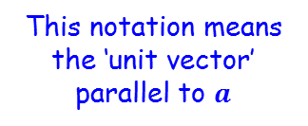


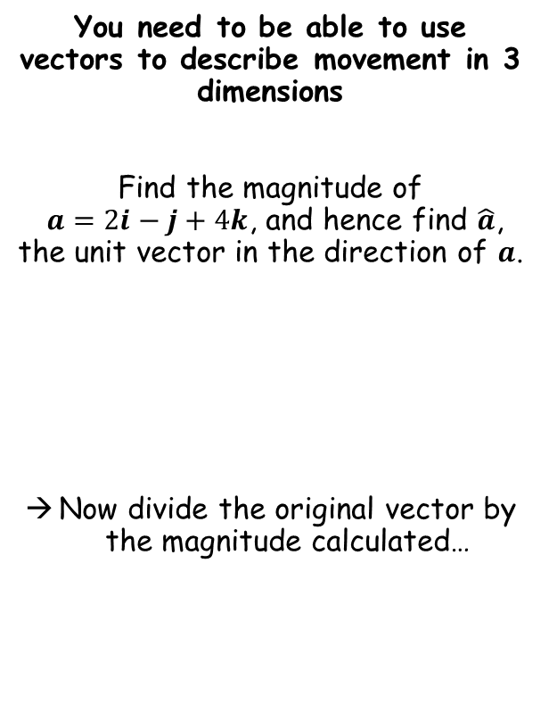



Vectors
You need to be able to use vectors to describe movement in 3 dimensions
Find the magnitude of
$a=2i−j+4k$, and hence find $\hat{a}$, the unit vector in the direction of $a$.
Now divide the original vector by the magnitude calculated…
$$a=2i−j+4k$$
Divide by $\left|a\right|$
$$\hat{a}=\frac{1}{\sqrt{21}}\left(2i−j+4k \right)$$
This notation means the ‘unit vector’ parallel to $a$
$$\left|a\right|=\sqrt{{(2)}^{2}+{(−1)}^{2}+{(4)}^{2}}$$
Calculate and leave as a surd
$$\left|a\right|=\sqrt{21}$$
12B

Slide 11



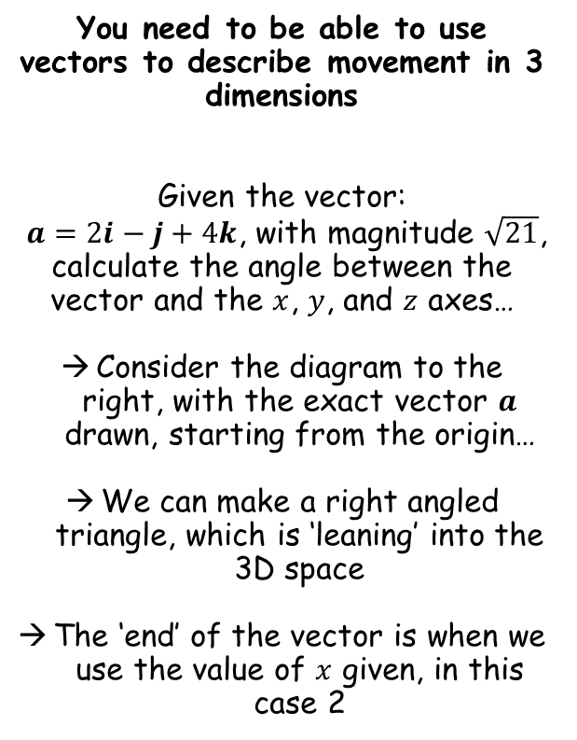




Vectors
z
You need to be able to use vectors to describe movement in 3 dimensions
Given the vector:
$a=2i−j+4k$, with magnitude $\sqrt{21}$, calculate the angle between the vector and the $x$, $y$, and $z$ axes…
Consider the diagram to the right, with the exact vector $a$ drawn, starting from the origin…
We can make a right angled triangle, which is ‘leaning’ into the 3D space
The ‘end’ of the vector is when we use the value of $x$ given, in this case 2
y
$$a$$
$$\left|a\right|$$
$$θ_{x}$$
$$x$$
x
$$Cosθ=\frac{Adj}{Hyp}$$
Sub in letters from the diagram
$$Cosθ_{x}=\frac{x}{\left|a\right|}$$
Sub in values from the diagram
$$Cosθ_{x}=\frac{2}{\sqrt{21}}$$
Inverse cos
$$θ_{x}=64.1^{°}$$
12B

Slide 12


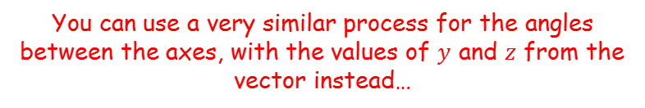

Vectors
z
You need to be able to use vectors to describe movement in 3 dimensions
Given the vector:
$a=2i−j+4k$, with magnitude $\sqrt{21}$, calculate the angle between the vector and the $x$, $y$, and $z$ axes…
Consider the diagram to the right, with the exact vector $a$ drawn, starting from the origin…
We can make a right angled triangle, which is ‘leaning’ into the 3D space
The ‘end’ of the vector is when we use the value of $x$ given, in this case 2
y
$$a$$
$$\left|a\right|$$
$$θ_{x}$$
$$x$$
x
You can use a very similar process for the angles between the axes, with the values of $y$ and $z$ from the vector instead…
$$Cosθ_{y}=\frac{y}{\left|a\right|}$$
Sub in values from the diagram
$$Cosθ_{y}=\frac{−1}{\sqrt{21}}$$
Inverse cos
$$θ_{y}=102.6^{°}$$
12B

Slide 13



Vectors
z
You need to be able to use vectors to describe movement in 3 dimensions
Given the vector:
$a=2i−j+4k$, with magnitude $\sqrt{21}$, calculate the angle between the vector and the $x$, $y$, and $z$ axes…
Consider the diagram to the right, with the exact vector $a$ drawn, starting from the origin…
We can make a right angled triangle, which is ‘leaning’ into the 3D space
The ‘end’ of the vector is when we use the value of $x$ given, in this case 2
y
$$a$$
$$\left|a\right|$$
$$θ_{x}$$
$$x$$
x
You can use a very similar process for the angles between the axes, with the values of $y$ and $z$ from the vector instead…
$$Cosθ_{z}=\frac{y}{\left|a\right|}$$
Sub in values from the diagram
$$Cosθ_{z}=\frac{4}{\sqrt{21}}$$
Inverse cos
$$θ_{y}=29.2^{°}$$
12B

Slide 14



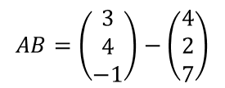












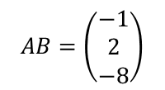


Vectors
You need to be able to use vectors to describe movement in 3 dimensions
The points $A$ and $B$ have position vectors $4i+2j+7k$ and $3i+4j−k$ relative to a fixed origin O. Find $\vec{AB}$ and show that $∆OAB$ is isosceles.
$$AB=b−a$$
Find the vector AB
$$AB=\left(\begin{matrix}3 \\ 4 \\ −1\end{matrix}\right)−\left(\begin{matrix}4 \\ 2 \\ 7\end{matrix}\right)$$
$$AB=\left(\begin{matrix}−1 \\ 2 \\ −8\end{matrix}\right)$$
$$|AB|=\sqrt{{(−1)}^{2}+2^{2}+{(−8)}^{2}}$$
Now find the magnitude of AB
Sketch (not to scale)
$$A$$
$$|AB|=\sqrt{69}$$
$$\left(\begin{matrix}4 \\ 2 \\ 7\end{matrix}\right)$$
$$\left(\begin{matrix}−1 \\ 2 \\ −8\end{matrix}\right)$$
$$|OA|=\sqrt{4^{2}+2^{2}+7^{2}}$$
$$|OA|=\sqrt{69}$$
Find the magnitude of OA and OB using their position vectors
$$\sqrt{69}$$
$$\sqrt{69}$$
$$|OB|=\sqrt{3^{2}+4^{2}+{(−1)}^{2}}$$
$$O$$
$$\left(\begin{matrix}3 \\ 4 \\ −1\end{matrix}\right)$$
$$B$$
$$|OB|=\sqrt{26}$$
Isosceles as 2 vectors have equal magnitudes
$$\sqrt{26}$$
12B

