Slide 1
Vectors
Twitter: @Owen134866
www.mathsfreeresourcelibrary.com

Slide 2
Prior Knowledge Check
Given that $p=3i−j$ and $q=−i+2j$, calculate:
a) $2p+q$
b) $−3p+4q$
2) Given that $a=5i−3j$, work out:
The magnitude of $a$
The unit vector that is parallel to $a$
3) M is the midpoint of the line segment AB.
Given that $\vec{AB}=4i+j$,
Find $\vec{BM}$ in terms of $i$ and $j$
The point $P$ lies on $AB$ such that $AB:PB=3:1$.
b) Find $\vec{AP}$ in terms of $i$ and $j$
$$5i$$
$$−13i+11j$$
$$−2i−\frac{1}{2}j$$
$$\sqrt{34}$$
$$3i+\frac{3}{4}j$$
$$\frac{5}{\sqrt{34}}i−\frac{3}{\sqrt{34}}j$$

Slide 3
Teachings for
Exercise 12A

Slide 4
Vectors
You need to be able to use coordinates in 3 dimensions
Find the distance from the origin to the point P(4, 2, 5)
z
Cartesian coordinates in three dimensions are usually referred to as the x, y and z axes, each at right-angles to the other.
Coordinates in 3 dimensions are given in the form (x, y, z)
5
4
z
y
x
2
Imagine the x and y-axes have fallen down flat, and the z-axis sticks up vertically out of the origin…
You can use the 3D version of Pythagoras’ Theorem
→ The distance from the origin to the point (x, y, z) is given by:
$$\sqrt{x^{2}{+y}^{2}{+z}^{2}}$$
$$=\sqrt{4^{2}{+2}^{2}{+5}^{2}}$$
y
x
$$=6.71$$
(2dp)
12A

Slide 5
Vectors
You need to be able to use coordinates in 3 dimensions
Find the distance between the points A(1, 3, 4) and B(8, 6, -5)
Cartesian coordinates in three dimensions are usually referred to as the x, y and z axes, each at right-angles to the other.
Coordinates in 3 dimensions are given in the form (x, y, z)
First calculate the vector from A to B
$$AB=$$
$$b−a$$
$$=\left(\begin{matrix}8 \\ 6 \\ −5\end{matrix}\right)−\left(\begin{matrix}1 \\ 3 \\ 4\end{matrix}\right)$$
$$=\left(\begin{matrix}7 \\ 3 \\ −9\end{matrix}\right)$$
z
$$\sqrt{7^{2}+3^{2}+{(−9)}^{2}}$$
Then use 3D Pythagoras
$$|AB|=$$
$$= \sqrt{139}$$
$$=11.8$$
(1dp)
y
x
12A

Slide 6
Vectors
The coordinates of A and B are (5, 0, 3) and (4, 2, k) respectively. Given that |AB| is 3 units, find the possible values of k
You need to be able to use coordinates in 3 dimensions
$$AB=\left(\begin{matrix}4 \\ 2 \\ k\end{matrix}\right)−\left(\begin{matrix}5 \\ 0 \\ 3\end{matrix}\right)$$
Cartesian coordinates in three dimensions are usually referred to as the x, y and z axes, each at right-angles to the other.
Coordinates in 3 dimensions are given in the form (x, y, z)
Calculate $AB$ using k
$$AB=\left(\begin{matrix}−1 \\ 2 \\ k−3\end{matrix}\right)$$
Use Pythagoras in 3D
z
$$\left|AB\right|=\sqrt{{(−1)}^{2}+2^{2}+{(k−3)}^{2}}$$
Careful when squaring the bracket
$$\left|AB\right|=\sqrt{k^{2}−6k+14}$$
|AB| = 3
$$3=\sqrt{k^{2}−6k+14}$$
Square both sides
$$9=k^{2}−6k+14$$
Solve as a quadratic
$$0=k^{2}−6k+5$$
y
$$0=(k−5)(k−1)$$
x
$$k=5 or k=1$$
12A

Slide 7
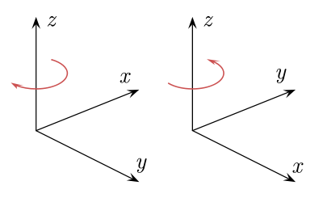
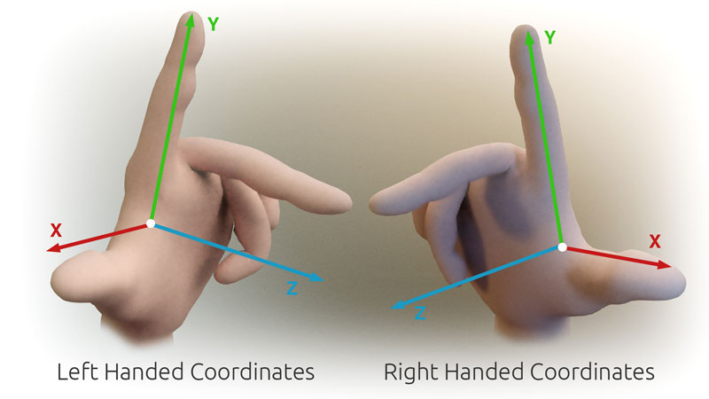
Vectors
You need to be able to use coordinates in 3 dimensions
Please note that when operating in 3D, there can be some inconsistencies with which way the axes are labelled!
Sometimes referred to as left handed or right handed!
12A

Slide 8
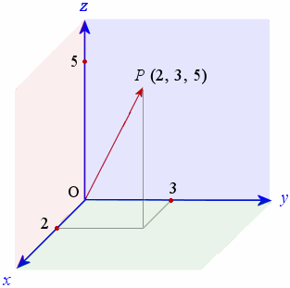
Vectors
You need to be able to use coordinates in 3 dimensions
Stick to this way!
Please note that when operating in 3D, there can be some inconsistencies with which way the axes are labelled!
12A

