Slide 1
3D coordinates (12.1)

Slide 2
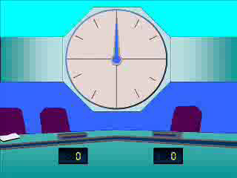
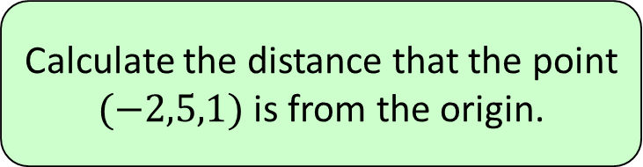


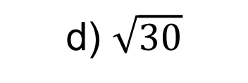

1
Calculate the distance that the point
$(−2,5,1)$ is from the origin.
a) $3$
b) $4$
c) $\sqrt{21}$
d) $\sqrt{30}$

Slide 3
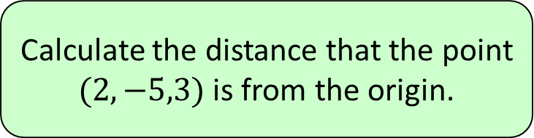


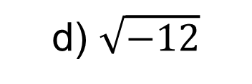

2
Calculate the distance that the point
$(2,−5,3)$ is from the origin.
a) $0$
b) $6$
c) $\sqrt{38}$
d) $\sqrt{−12}$

Slide 4
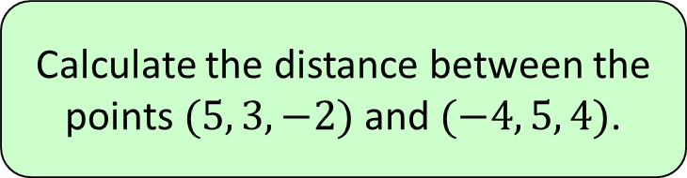


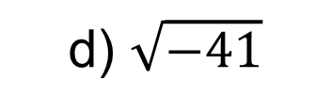

3
Calculate the distance between the
points $(5, 3, −2)$ and $(−4, 5, 4)$.
a) $11$
b) $121$
c) $\sqrt{41}$
d) $\sqrt{−41}$

Slide 5
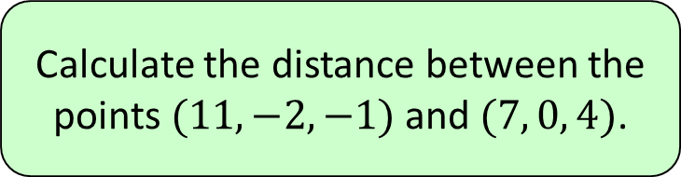


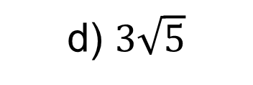

4
Calculate the distance between the
points $(11, −2, −1)$ and $(7, 0, 4)$.
a) $\sqrt{29}$
b) $29$
c) $5\sqrt{3}$
d) $3\sqrt{5}$

