Slide 1
Modelling with differential equations (11.11)

Slide 2
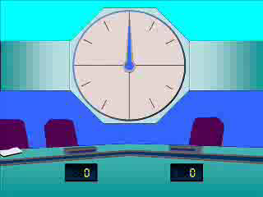
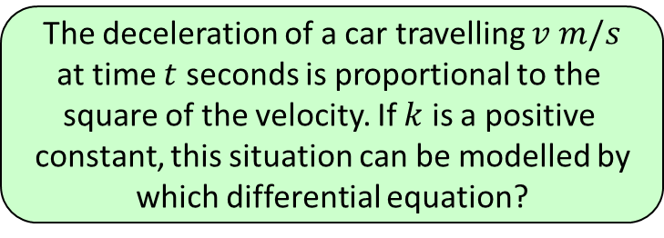




1
The deceleration of a car travelling $v m/s$
at time $t$ seconds is proportional to the
square of the velocity. If $k$ is a positive
constant, this situation can be modelled by
which differential equation?
a) $−\frac{dv}{dt}=k+v^{2}$
b) $\frac{dv}{dt}=−kv^{2}$
c) $\frac{dv}{dt}=kv^{2}$
d) $\frac{dt}{dv}=−kv^{2}$

Slide 3
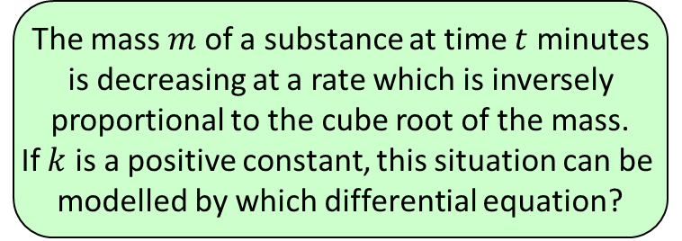
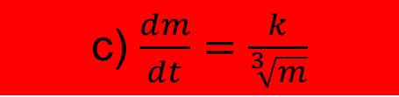
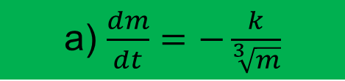
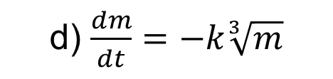
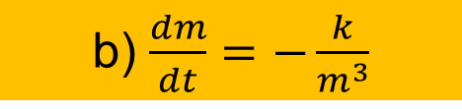
2
The mass $m$ of a substance at time $t$ minutes
is decreasing at a rate which is inversely
proportional to the cube root of the mass.
If $k$ is a positive constant, this situation can be
modelled by which differential equation?
a) $\frac{dm}{dt}=−\frac{k}{\sqrt[3]{m}}$
b) $\frac{dm}{dt}=−\frac{k}{m^{3}}$
c) $\frac{dm}{dt}=\frac{k}{\sqrt[3]{m}}$
d) $\frac{dm}{dt}=−k\sqrt[3]{m}$

Slide 4
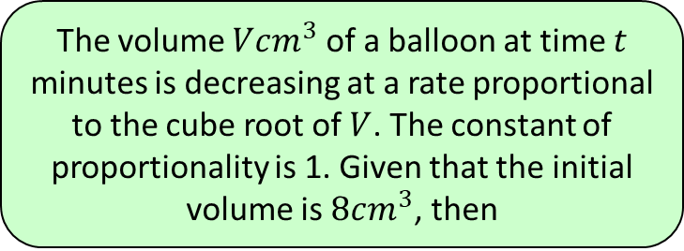
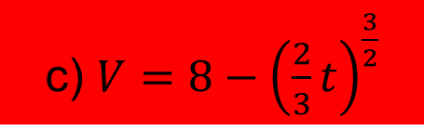
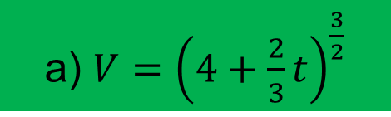
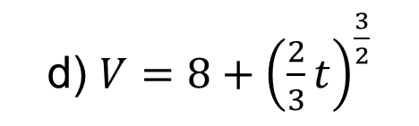
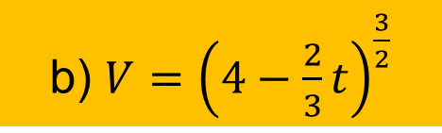
3
The volume $Vcm^{3}$ of a balloon at time $t$
minutes is decreasing at a rate proportional
to the cube root of $V$. The constant of
proportionality is 1. Given that the initial
volume is $8cm^{3}$, then
a) $V={\left(4+\frac{2}{3}t\right)}^{\frac{3}{2}}$
b) $V={\left(4−\frac{2}{3}t\right)}^{\frac{3}{2}}$
c) $V=8−{\left(\frac{2}{3}t\right)}^{\frac{3}{2}}$
d) $V=8+{\left(\frac{2}{3}t\right)}^{\frac{3}{2}}$

