Slide 1
Solving differential equations (11.10)

Slide 2
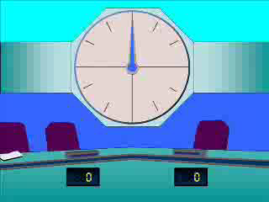
1
Find the general solution of the
following differential equation
$$\frac{dy}{dx}=6x^{2}+4x$$
a) $y=12x+4$
b) $\frac{1}{2}y^{2}=2x^{3}+2x^{2}+c$
c) $y=2x^{3}+2x^{2}$
d) $y=2x^{3}+2x^{2}+c$

Slide 3
2
Find the general solution of the
following differential equation:
$$\frac{dy}{dx}=6xy$$
a) $y=\sqrt{\frac{1}{3x^{2}+c}}$
b) $y=Ae^{3x^{2}}$
c) $y=kx^{6}$
d) $y=3x^{2}+c$

Slide 4
3
Find the general solution of the
following differential equation:
$$\frac{dy}{dx}=2x^{3}y^{2}$$
a) $y=\sqrt[3]{\frac{3x^{4}}{2}+c}$
b) $y=\sqrt[3]{−\frac{2}{x^{4}}+c}$
c) $y=−\frac{2}{x^{4}}+c$
d) $y=\frac{x^{2}}{\sqrt{2}}+c$

