Slide 1
The trapezium rule (11.9)

Slide 2
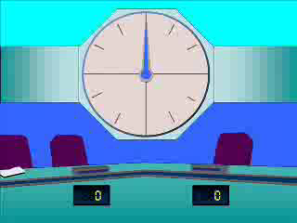
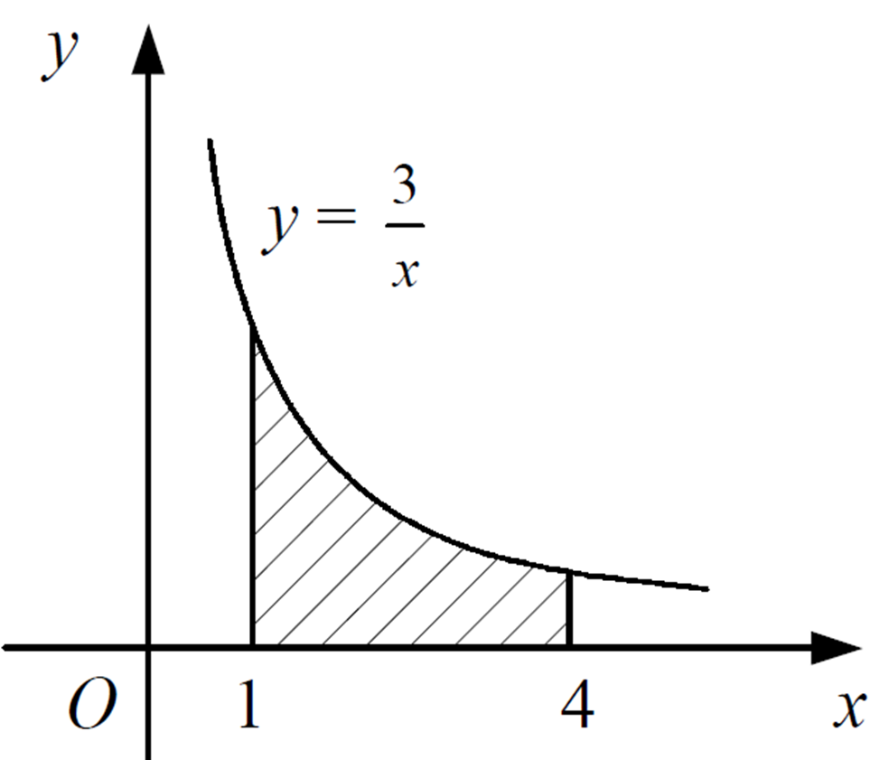
1
If we used the Trapezium rule with
3 strips, would our estimate for the
shaded area be
a) An overestimate
b) An underestimate
c) Exactly right
d) Impossible to tell

Slide 3
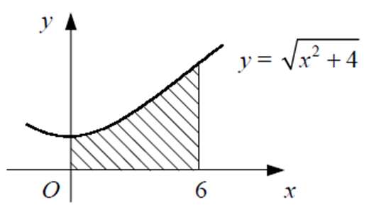
2
If we used the Trapezium rule with
2 strips, would our estimate for the
shaded area be
a) An overestimate
b) An underestimate
c) Exactly right
d) Impossible to tell

Slide 4
3
If we used the Trapezium rule with
2 strips, what would our estimate be for
the shaded area?
a) 5.7
b) 20.7
c) 10.7
d) 15.7

