Slide 1
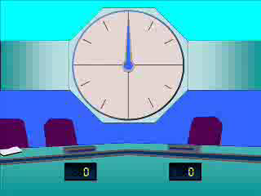
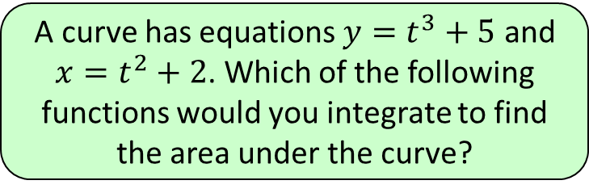
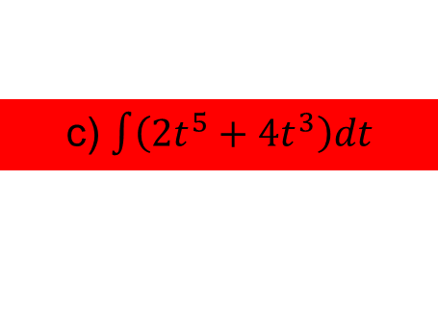
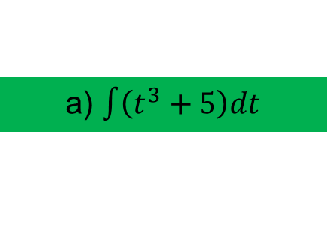
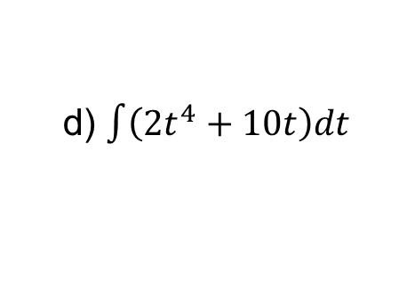
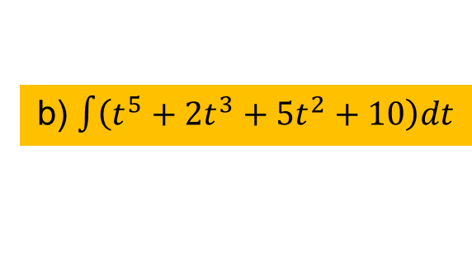
4
A curve has equations $y=t^{3}+5$ and
$x=t^{2}+2$. Which of the following
functions would you integrate to find
the area under the curve?
a) $\int{\left(t^{3}+5\right)dt}$
b) $\int{\left(t^{5}+2t^{3}+5t^{2}+10\right)dt}$
c) $\int{\left(2t^{5}+4t^{3}\right)dt}$
d) $\int{\left(2t^{4}+10t\right)dt}$

