Slide 1
Teachings for
Exercise 11H

Slide 2






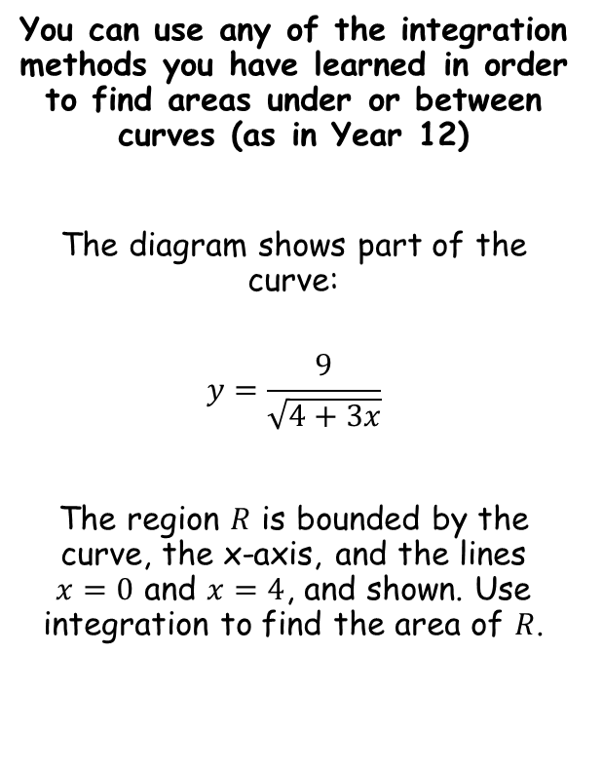









Integration
$${\left(4+3x\right)}^{\frac{1}{2}}$$
Differentiate using the chain rule
$$y$$
$${\frac{1}{2}\left(4+3x\right)}^{−\frac{1}{2}}(3)$$
You can use any of the integration methods you have learned in order to find areas under or between curves (as in Year 12)
The diagram shows part of the curve:
$$y=\frac{9}{\sqrt{4+3x}}$$
The region $R$ is bounded by the curve, the x-axis, and the lines $x=0$ and $x=4$, and shown. Use integration to find the area of $R$.
Simplify
$$\frac{9}{2}$$
$$={\frac{3}{2}\left(4+3x\right)}^{−\frac{1}{2}}$$
This gives us the integral below, but 6 times too small
→ So the original guess needs to be multiplied by 6
$$R$$
$$x$$
$$0$$
$$4$$
$$\int_{0}^{4}{\frac{9}{\sqrt{4+3x}}} dx$$
Rewrite as a power
$$=\int_{0}^{4}{9{\left(4+3x\right)}^{−\frac{1}{2}}} dx$$
Integrate (see what ${\left(4+3x\right)}^{−\frac{1}{2}}$ would differentiate to first…)
$$={\left[{6\left(4+3x\right)}^{\frac{1}{2}}\right]}_{0}^{4}$$
Sub in values and subtract
$$=\left({6\left(4+3(4)\right)}^{\frac{1}{2}}\right)−\left({6\left(4+3(0)\right)}^{\frac{1}{2}}\right)$$
Calculate
$$=12 square units$$
11H

Slide 3



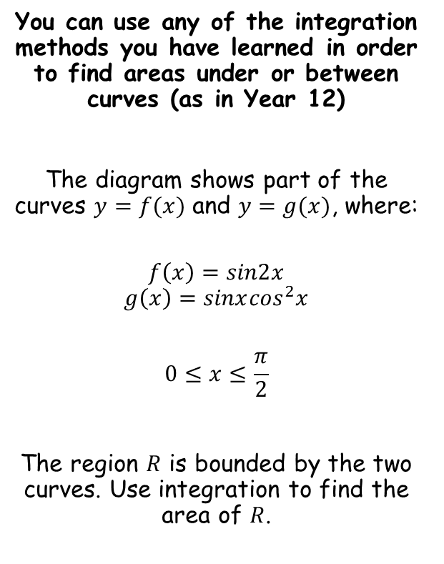




Integration
$$y$$
You can use any of the integration methods you have learned in order to find areas under or between curves (as in Year 12)
The diagram shows part of the curves $y=f(x)$ and $y=g(x)$, where:
$$f\left(x\right)=sin2x$$
$$g\left(x\right)=sinx\cos^{2}x$$
$$0≤x≤\frac{π}{2}$$
The region $R$ is bounded by the two curves. Use integration to find the area of $R$.
$$1$$
$$y=f(x)$$
$$R$$
$$y=g(x)$$
$$x$$
$$0$$
$$\frac{π}{2}$$
To find the area between two curves, you can subtract the ‘lower’ curve from the higher curve (as long as the curves do not intersect between the limits)
$$\int_{0}^{\frac{π}{2}}{\left(f\left(x\right)−g(x)\right)} dx$$
Sub in functions
$$=\int_{0}^{\frac{π}{2}}{\left(sin2x−sinx\cos^{2}x\right)} dx$$
11H

Slide 4










Integration
$$=\int_{0}^{\frac{π}{2}}{\left(sin2x−sinx\cos^{2}x\right)} dx$$
You can use any of the integration methods you have learned in order to find areas under or between curves (as in Year 12)
The diagram shows part of the curves $y=f(x)$ and $y=g(x)$, where:
$$f\left(x\right)=sin2x$$
$$g\left(x\right)=sinx\cos^{2}x$$
$$0≤x≤\frac{π}{2}$$
The region $R$ is bounded by the two curves. Use integration to find the area of $R$.
Integrate each term separately using the patterns below
Sub in limits
$$={\left[−\frac{1}{2}cos2x+\frac{1}{3}\cos^{3}x\right]}_{0}^{\frac{π}{2}}$$
$$=\left(−\frac{1}{2}cos2\left(\frac{π}{2}\right)+\frac{1}{3}\cos^{3}\left(\frac{π}{2}\right)\right)−\left(−\frac{1}{2}cos2(0)+\frac{1}{3}\cos^{3}(0)\right)$$
$$=\frac{2}{3}$$
Calculate
$$cos2x$$
$$\cos^{3}x$$
Differentiate
Differentiate
$$−2sin2x$$
$${3cos}^{2}xsinx$$
So we need to divide the original guess by $−2$
So we need to divide the original guess by $3$
11H

