Slide 1
Finding areas (includes parametric) (11.8)

Slide 2
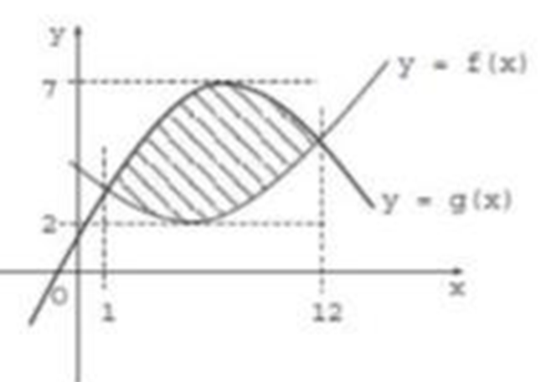
1
The graphs of functions $f$ and $g$ are
shown in the diagram below. Which of
the following gives the area of the
shaded region?
a) $\int_{1}^{12}{\left(g\left(x\right)−f\left(x\right)\right)dx}$
b) $\int_{2}^{7}{\left(g\left(x\right)−f\left(x\right)\right)dx}$
c) $\int_{1}^{12}{\left(f\left(x\right)−g\left(x\right)\right)dx}$
d) $\int_{2}^{7}{\left(f\left(x\right)−g\left(x\right)\right)dx}$

Slide 3
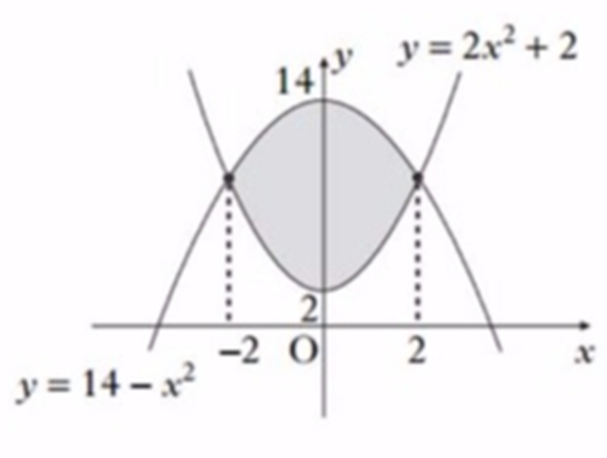
2
The diagram shows graphs with
equations $y=14−x^{2}$ and $y=2x^{2}+2$.
Which of the following represents
the shaded area?
a) $\int_{2}^{14}{\left(12−3x^{2}\right)dx}$
b) $\int_{−2}^{2}{\left(12−3x^{2}\right)dx}$
c) $\int_{2}^{14}{\left(3x^{2}−12\right)dx}$
d) $\int_{−2}^{2}{\left(3x^{2}−12\right)dx}$

Slide 4
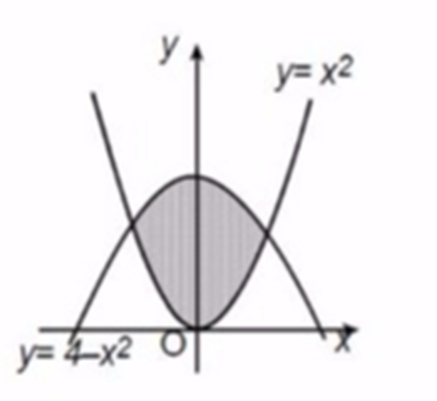
3
The diagram shows graphs with
equations $y=4−x^{2}$ and $y=x^{2}$.
Which of the following represents
the shaded area?
a) $\int_{−\sqrt{2}}^{\sqrt{2}}{\left(4−2x^{2}\right)dx}$
b) $\int_{0}^{4}{\left(4−2x^{2}\right)dx}$
c) $\int_{0}^{\sqrt{2}}{\left(4−2x^{2}\right)dx}$
d) $\int_{−2}^{2}{\left(4−2x^{2}\right)dx}$

