Slide 1
Partial fractions (11.7)

Slide 2
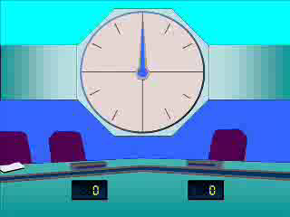
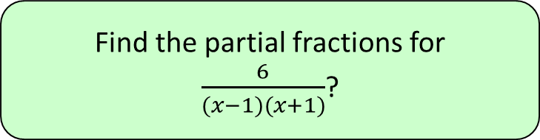




1
Find the partial fractions for
$\frac{6}{(x−1)(x+1)}$?
a) $\frac{A}{x+1}+\frac{B}{x+1}$
b) $\frac{A}{x−1}+\frac{B}{x−1}$
c) $\frac{A}{x−1}+\frac{B}{x+1}$
d) ?
Now solve for A and B
$$A=3, B=−3$$

Slide 3
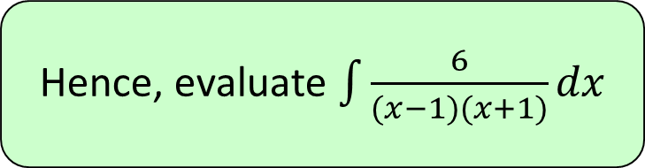



2
Hence, evaluate $\int{\frac{6}{(x−1)(x+1)}dx}$
a) $3ln\left|x+1\right|−3ln\left|x−1\right|+c$
b) $3ln\left|x−1\right|−3ln\left|x+1\right|+c$
c) $3ln\left|x+1\right|+3ln\left|x−1\right|+c$
d) ?

Slide 4
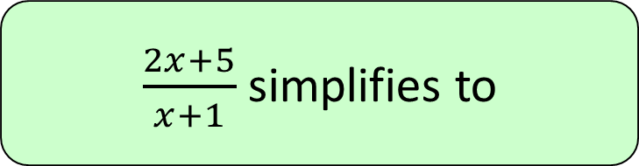




3
$\frac{2x+5}{x+1}$ simplifies to
a) $2+\frac{4}{x+1}$
b) $2+\frac{3}{x−1}$
c) $3+\frac{2}{x+1}$
d) $2+\frac{5}{x−1}$

Slide 5
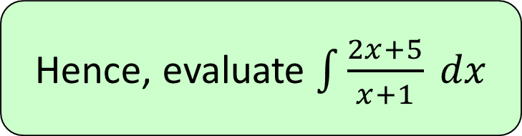




4
Hence, evaluate $\int{\frac{2x+5}{x+1} dx}$
a) $2x+\frac{1}{3}ln\left|x+1\right|+c$
b) $2x+3ln\left|x+1\right|+c$
c) $2x−3ln\left|x+1\right|+c$
d) $2x−\frac{1}{3}ln\left|x+1\right|+c$

