Slide 1
Integration by parts (11.6)

Slide 2
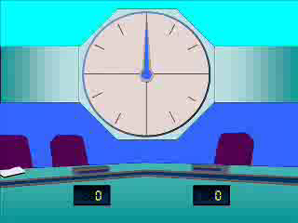
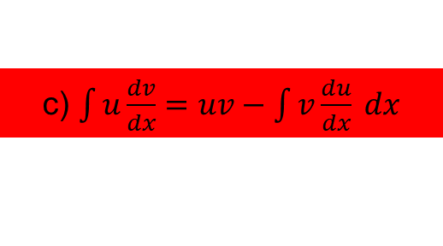
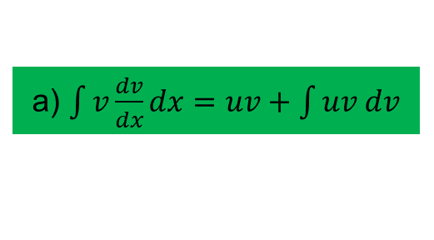
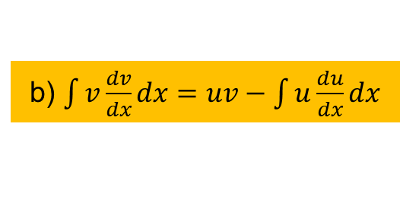
1
What is the formula for integration by
parts?
a) $\int{v\frac{dv}{dx}dx=uv+\int{uv dv}}$
b) $\int{v\frac{dv}{dx}dx=uv−\int{u\frac{du}{dx}dx}}$
c) $\int{u\frac{dv}{dx}=uv−\int{v\frac{du}{dx} dx}}$
d) ?

Slide 3
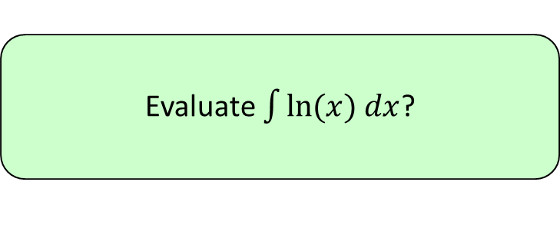


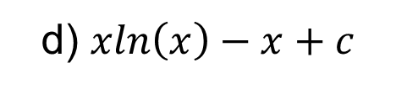
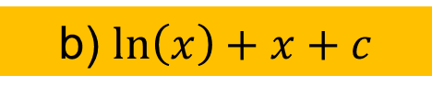
2
Evaluate $\int{ln⁡(x) dx}$?
a) $\frac{1}{x}+c$
b) $\ln\left(x\right)+x+c$
c) $\ln\left(x\right)+c$
d) $xln\left(x\right)−x+c$

Slide 4
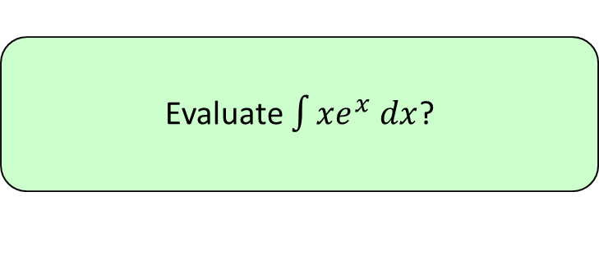


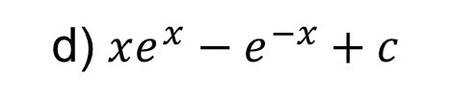

3
Evaluate $\int{xe^{x} dx}$?
a) $xe^{x}−e^{x}+c$
b) $xe+c$
c) $xe^{2}−e^{2}+c$
d) $xe^{x}−e^{−x}+c$

Slide 5
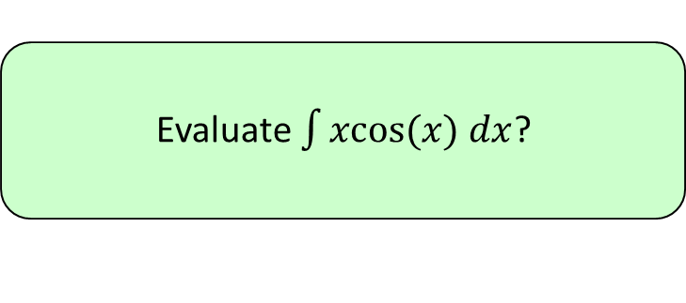


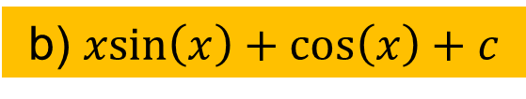
4
Evaluate $\int{xcos(x) dx}$?
a) $x^{2}\cos\left(x\right)+c$
b) $xsin\left(x\right)+\cos\left(x\right)+c$
c) $xsin\left(x\right)+c$
d) ?

