Slide 1
Teachings for
Exercise 11E

Slide 2





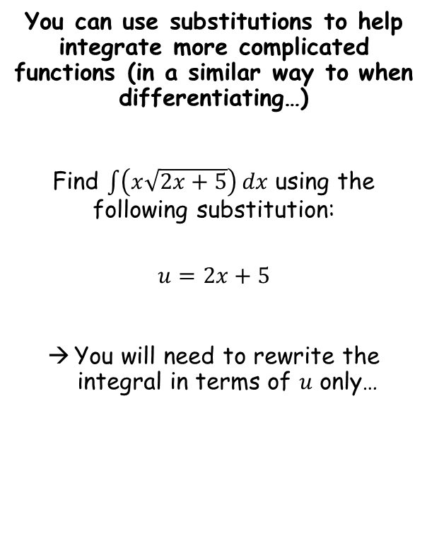
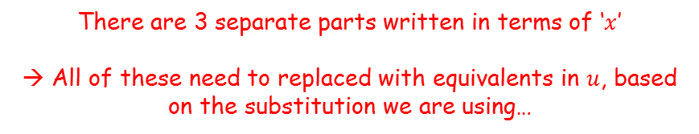







Integration
$$\left(x\sqrt{2x+5}\right) dx$$
You can use substitutions to help integrate more complicated functions (in a similar way to when differentiating…)
Find $\int{\left(x\sqrt{2x+5}\right)}dx$ using the following substitution:
$$u=2x+5$$
You will need to rewrite the integral in terms of $u$ only…
$$x$$
$$2x+5$$
$$dx$$
There are 3 separate parts written in terms of ‘$x$’
→ All of these need to replaced with equivalents in $u$, based on the substitution we are using…
$$u=2x+5$$
Subtract 5 and divide by 2
Differentiate
$$\frac{u−5}{2}=x$$
$$\frac{du}{dx}=2$$
Multiply by $dx$
$$du=2dx$$
$$\frac{1}{2}du=dx$$
Divide by 2
We now have expressions in $u$ for all of the $x$ terms in the original integral…
11E

Slide 3

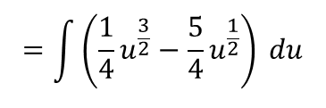



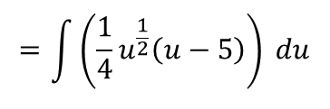

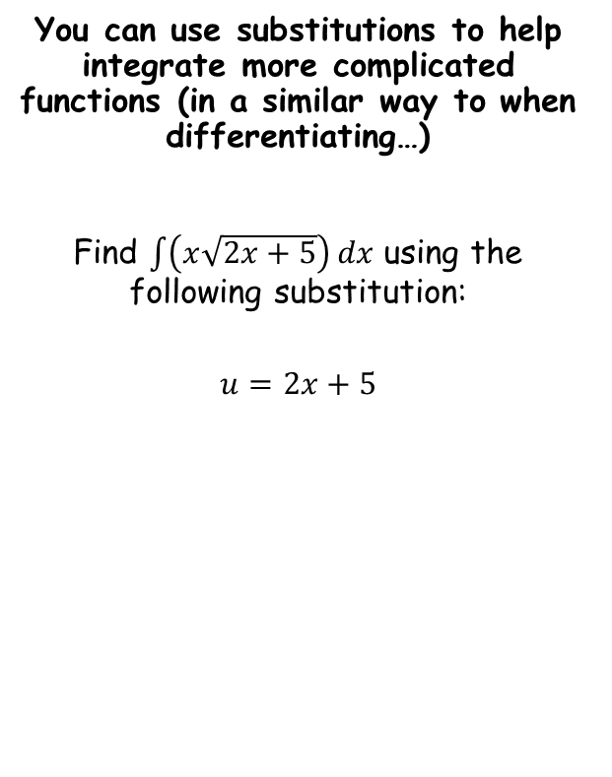
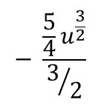



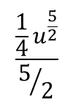





Integration
$$\left(x\sqrt{2x+5}\right) dx$$
You can use substitutions to help integrate more complicated functions (in a similar way to when differentiating…)
Find $\int{\left(x\sqrt{2x+5}\right)}dx$ using the following substitution:
$$u=2x+5$$
Replace each term in $x$ with expressions in $u$
$$=\int{}$$
$$\left(\frac{u−5}{2}\right)$$
$$\frac{1}{2}du$$
$$\sqrt{u}$$
Rewrite/simplify
$$=\int{\left(\frac{1}{4}u^{\frac{1}{2}}\left(u−5\right)\right) du}$$
Expand the bracket
$$=\int{\left(\frac{1}{4}u^{\frac{3}{2}}−\frac{5}{4}u^{\frac{1}{2}}\right) du}$$
Integrate each term separately
$$\frac{\frac{1}{4}u^{\frac{5}{2}}}{5/2}$$
$$− \frac{\frac{5}{4}u^{\frac{3}{2}}}{3/2}$$
$$x=\frac{u−5}{2}$$
$$\frac{1}{2}du=dx$$
$$=$$
$$+ c$$
Simplify
$$=\frac{1}{10}u^{\frac{5}{2}}−\frac{5}{6}u^{\frac{3}{2}}+c$$
Finally, we can replace all terms with the original substitution that we used!
$$=\frac{1}{10}{\left(2x+5 \right)}^{\frac{5}{2}}−\frac{5}{6}{\left(2x+5 \right)}^{\frac{3}{2}}+c$$
11E

Slide 4


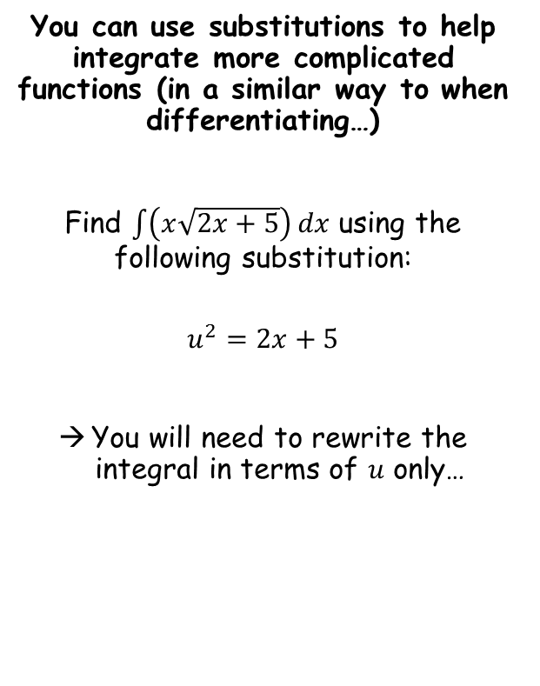



Integration
$$\left(x\sqrt{2x+5}\right) dx$$
You can use substitutions to help integrate more complicated functions (in a similar way to when differentiating…)
Find $\int{\left(x\sqrt{2x+5}\right)}dx$ using the following substitution:
$$u^{2}=2x+5$$
You will need to rewrite the integral in terms of $u$ only…
$$x$$
$$2x+5$$
$$dx$$
There are 3 separate parts written in terms of ‘$x$’
→ All of these need to replaced with equivalents in $u$, based on the substitution we are using…
$$u^{2}=2x+5$$
Subtract 5 and divide by 2
Differentiate
$$\frac{u^{2}−5}{2}=x$$
$$2u\frac{du}{dx}=2$$
Multiply by $dx$
$$2u du=2dx$$
Divide by 2
$$u du=dx$$
We now have expressions in $u$ for all of the $x$ terms in the original integral…
11E

Slide 5

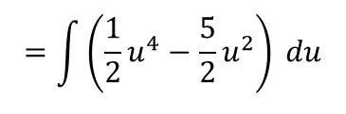




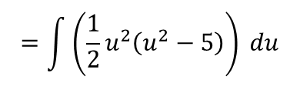


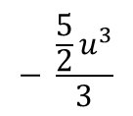





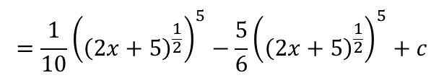




Integration
$$\left(x\sqrt{2x+5}\right) dx$$
Replace each term in $x$ with expressions in $u$
You can use substitutions to help integrate more complicated functions (in a similar way to when differentiating…)
Find $\int{\left(x\sqrt{2x+5}\right)}dx$ using the following substitution:
$$u^{2}=2x+5$$
$$=\int{}$$
$$\left(\frac{u^{2}−5}{2}\right)$$
$$\sqrt{u^{2}}$$
$$u du$$
Rewrite/simplify
$$=\int{\left(\frac{1}{2}u^{2}\left(u^{2}−5\right)\right) du}$$
Expand the bracket
$$=\int{\left(\frac{1}{2}u^{4}−\frac{5}{2}u^{2}\right) du}$$
Integrate each term separately
$$\frac{\frac{1}{2}u^{5}}{5}$$
$$− \frac{\frac{5}{2}u^{3}}{3}$$
Square root both sides
$$+ c$$
$$x=\frac{u^{2}−5}{2}$$
$$=$$
$$u du=dx$$
Simplify
$$=\frac{1}{10}u^{5}−\frac{5}{6}u^{3}+c$$
Finally, we can replace all terms with a substitution for $u$
$$u={\left(2x+5 \right)}^{\frac{1}{2}}$$
$$=\frac{1}{10}{\left({\left(2x+5\right)}^{\frac{1}{2}}\right)}^{5}−\frac{5}{6}{\left({\left(2x+5\right)}^{\frac{1}{2}}\right)}^{5}+c$$
The answer we got here is exactly the same as using the previous substitution!
$$=\frac{1}{10}{\left(2x+5\right)}^{\frac{5}{2}}−\frac{5}{6}{\left(2x+5\right)}^{\frac{3}{2}}+c$$
Rewrite
11E

Slide 6
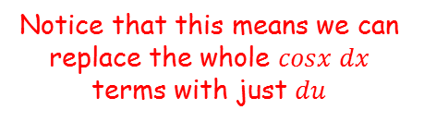

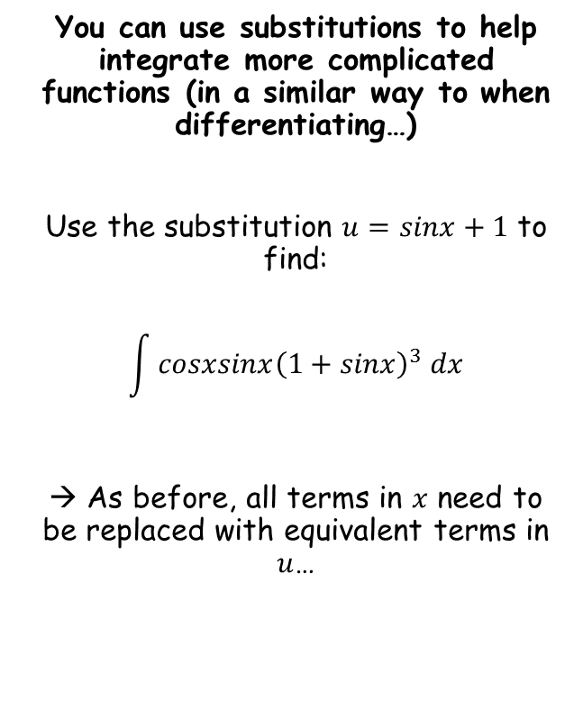



Integration
$$u=sinx+1$$
You can use substitutions to help integrate more complicated functions (in a similar way to when differentiating…)
Use the substitution $u=sinx+1$ to find:
$$\int{cosxsinx{\left(1+sinx\right)}^{3} dx}$$
→ As before, all terms in $x$ need to be replaced with equivalent terms in $u$…
Subtract 1
Differentiate
$$u−1=sinx$$
$$\frac{du}{dx}=cosx$$
Multiply by $dx$
$$du=cosx dx$$
Notice that this means we can replace the whole $cosx dx$ terms with just $du$
11E

Slide 7





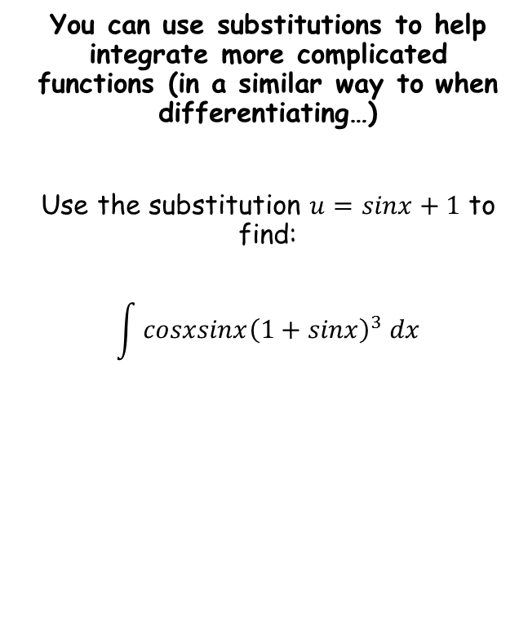
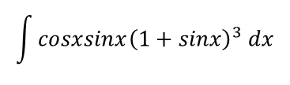
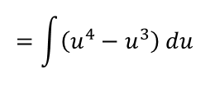




Integration
$$\int{cosxsinx{\left(1+sinx\right)}^{3} dx}$$
You can use substitutions to help integrate more complicated functions (in a similar way to when differentiating…)
Use the substitution $u=sinx+1$ to find:
$$\int{cosxsinx{\left(1+sinx\right)}^{3} dx}$$
Rewrite using the expressions we found
$$=\int{}$$
$${\left(u\right)}^{3}$$
$$\left(u−1\right)$$
$$du$$
Multiply out
$$=\int{\left(u^{4}−u^{3}\right) du}$$
Integrate
$$=\frac{u^{5}}{5}−\frac{u^{4}}{4}+c$$
Use the original substitution for u…
$$=\frac{{\left(sinx+1\right)}^{5}}{5}−\frac{{\left(sinx+1\right)}^{4}}{4}+c$$
$$u=sinx+1$$
$$u−1=sinx$$
$$du=cosx dx$$
11E

Slide 8

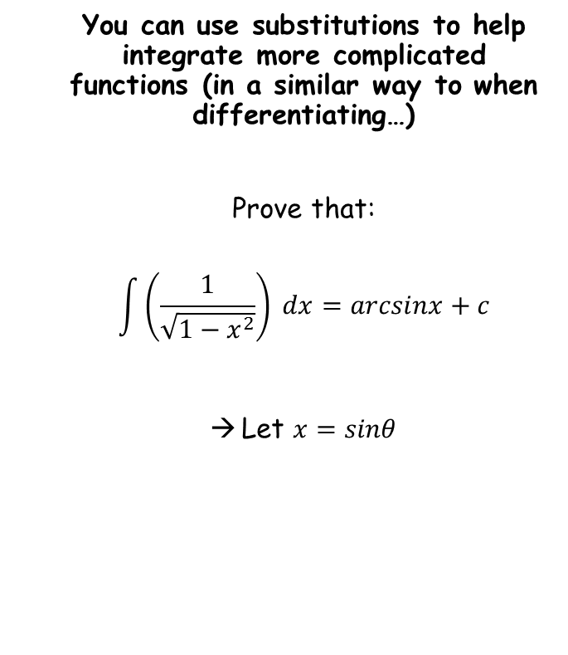



Integration
$$x=sinθ$$
You can use substitutions to help integrate more complicated functions (in a similar way to when differentiating…)
Prove that:
$$\int{\left(\frac{1}{\sqrt{1−x^{2}}}\right)} dx=arcsinx+c$$
Let $x=sinθ$
Differentiate
$$\frac{dx}{dθ}=cosθ$$
Multiply by $dθ$
$$dx=cosθ dθ$$
11E

Slide 9
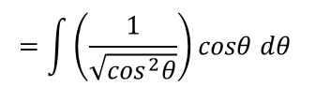









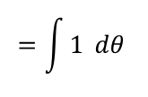
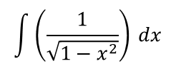
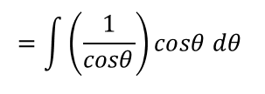

Integration
$$\int{\left(\frac{1}{\sqrt{1−x^{2}}}\right)} dx$$
You can use substitutions to help integrate more complicated functions (in a similar way to when differentiating…)
Prove that:
$$\int{\left(\frac{1}{\sqrt{1−x^{2}}}\right)} dx=arcsinx+c$$
Let $x=sinθ$
Replace the $x$ terms with expressions in $θ$
$$=\int{}$$
$$\left(\frac{1}{\sqrt{1−\sin^{2}θ}}\right)$$
$$cosθ dθ$$
Use an identity to replace $1−\sin^{2}θ$
$$=\int{\left(\frac{1}{\sqrt{\cos^{2}θ}}\right)}cosθ dθ$$
Simplify the denominator
$$=\int{\left(\frac{1}{cosθ}\right)}cosθ dθ$$
Simplify
$$=\int{1} dθ$$
Integrate
$$=θ+c$$
$$dx=cosθ dθ$$
Inverse sine
Replace $θ$ with an expression in $x$
$$=arcsinx+c$$
$$arcsinx=θ$$
11E

Slide 10

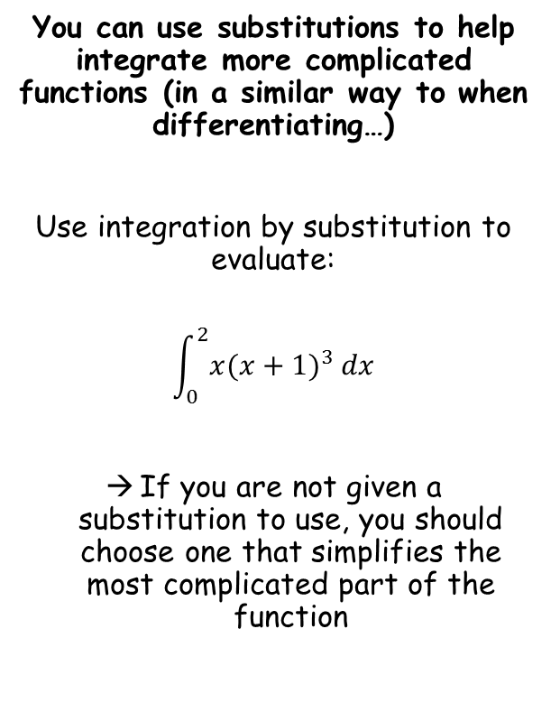



Integration
$$u=x+1$$
You can use substitutions to help integrate more complicated functions (in a similar way to when differentiating…)
Use integration by substitution to evaluate:
$$\int_{0}^{2}{x{(x+1)}^{3} dx}$$
If you are not given a substitution to use, you should choose one that simplifies the most complicated part of the function
Subtract 1
Differentiate
$$u−1=x$$
$$\frac{du}{dx}=1$$
Multiply by $dx$
$$du=dx$$
11E

Slide 11



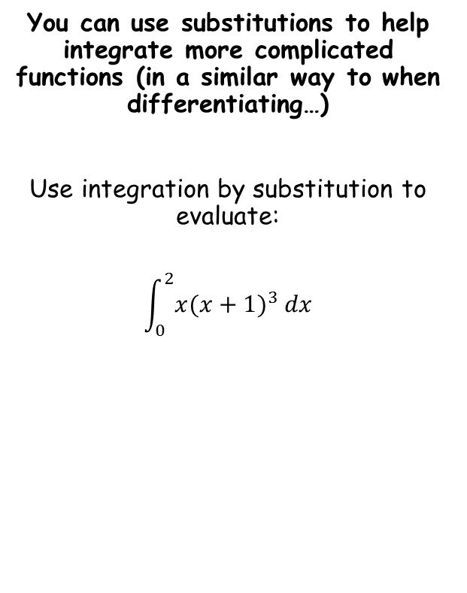
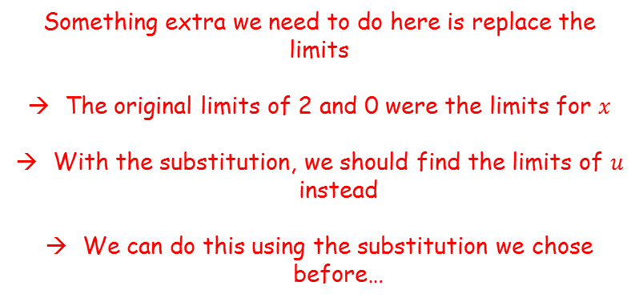





Integration
Something extra we need to do here is replace the limits
The original limits of 2 and 0 were the limits for $x$
With the substitution, we should find the limits of $u$ instead
We can do this using the substitution we chose before…
You can use substitutions to help integrate more complicated functions (in a similar way to when differentiating…)
Use integration by substitution to evaluate:
$$\int_{0}^{2}{x{(x+1)}^{3} dx}$$
$$u=x+1$$
When $x=2$
When $x=0$
$$u=x+1$$
$$u=3$$
$$u=1$$
$$u−1=x$$
$$du=dx$$
So when we do the substitution, we also need to replace the limits with 3 and 1…
Limits of 3 and 1
11E

Slide 12



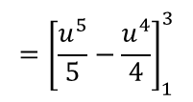
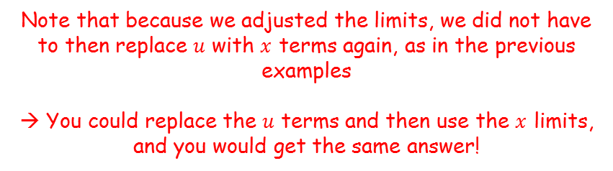


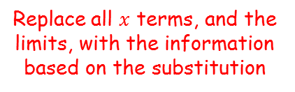



Integration
$$\int_{0}^{2}{x{(x+1)}^{3} dx}$$
You can use substitutions to help integrate more complicated functions (in a similar way to when differentiating…)
Use integration by substitution to evaluate:
$$\int_{0}^{2}{x{(x+1)}^{3} dx}$$
Replace all $x$ terms, and the limits, with the information based on the substitution
$$=\int_{1}^{3}{}$$
$$(u−1)$$
$${\left(u\right)}^{3}$$
$$du$$
Multiply out the bracket
$$=\int_{1}^{3}{\left(u^{4}−u^{3}\right) du}$$
Integrate
$$={\left[\frac{u^{5}}{5}−\frac{u^{4}}{4}\right]}_{1}^{3}$$
Sub in limits and subtract
$$=\left(\frac{{(3)}^{5}}{5}−\frac{{(3)}^{4}}{4}\right)−\left(\frac{{(1)}^{5}}{5}−\frac{{(1)}^{4}}{4}\right)$$
$$u=x+1$$
Calculate
$$=28.4$$
$$u−1=x$$
$$du=dx$$
Note that because we adjusted the limits, we did not have to then replace $u$ with $x$ terms again, as in the previous examples
→ You could replace the $u$ terms and then use the $x$ limits, and you would get the same answer!
Limits of 3 and 1
11E

Slide 13
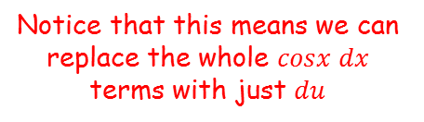


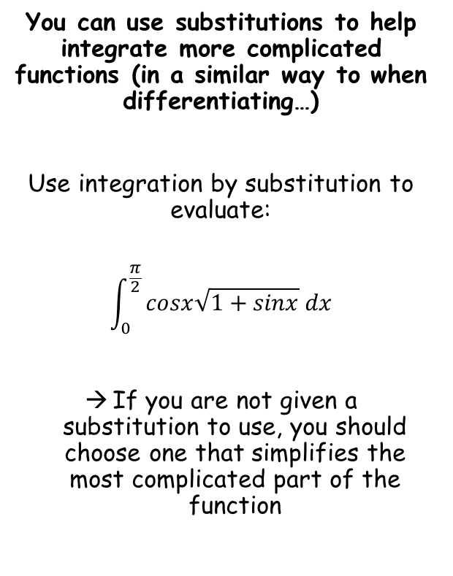


Integration
$$u=1+sinx$$
You can use substitutions to help integrate more complicated functions (in a similar way to when differentiating…)
Use integration by substitution to evaluate:
$$\int_{0}^{\frac{π}{2}}{cosx\sqrt{1+sinx} dx}$$
If you are not given a substitution to use, you should choose one that simplifies the most complicated part of the function
Subtract 1
Differentiate
$$u−1=sinx$$
$$\frac{du}{dx}=cosx$$
Multiply by $dx$
$$du=cosx dx$$
Notice that this means we can replace the whole $cosx dx$ terms with just $du$
11E

Slide 14



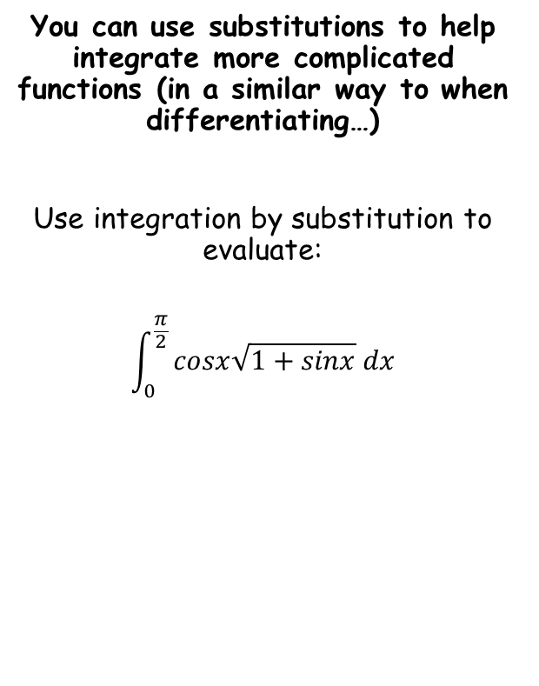





Integration
You can use substitutions to help integrate more complicated functions (in a similar way to when differentiating…)
Use integration by substitution to evaluate:
$$\int_{0}^{\frac{π}{2}}{cosx\sqrt{1+sinx} dx}$$
We also need to adjust the limits…
$$u=1+sinx$$
When $x=\frac{π}{2}$
When $x=0$
$$u=2$$
$$u=1$$
So when we do the substitution, we also need to replace the limits with 2 and 1…
$$u=1+sinx$$
$$u−1=sinx$$
$$du=cosx dx$$
Limits of 2 and 1
11E

Slide 15





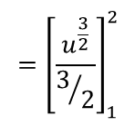



Integration
$$\int_{0}^{\frac{π}{2}}{cosx\sqrt{1+sinx} dx}$$
You can use substitutions to help integrate more complicated functions (in a similar way to when differentiating…)
Use integration by substitution to evaluate:
$$\int_{0}^{\frac{π}{2}}{cosx\sqrt{1+sinx} dx}$$
Replace terms using the substitutions we worked out
$$=\int_{1}^{2}{}$$
$$\sqrt{u}$$
$$du$$
Rewrite for integration
$$=\int_{1}^{2}{u^{\frac{1}{2}}} du$$
Integrate and use a square bracket
$$={\left[\frac{u^{\frac{3}{2}}}{3/2}\right]}_{1}^{2}$$
Rewrite
$$={\left[\frac{2}{3}u^{\frac{3}{2}}\right]}_{1}^{2}$$
$$u=1+sinx$$
Sub in values and subtract
$$=\left(\frac{2}{3}{(2)}^{\frac{3}{2}}\right)−\left(\frac{2}{3}{(1)}^{\frac{3}{2}}\right)$$
$$u−1=sinx$$
$$du=cosx dx$$
Calculate
Limits of 2 and 1
$$=\frac{2}{3}\left(2\sqrt{2}−1\right)$$
11E

