Slide 1
Integration by substitution (11.5)

Slide 2
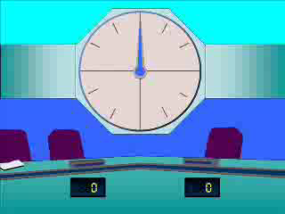
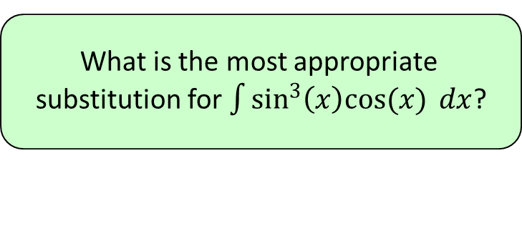
1
What is the most appropriate
substitution for $\int{\sin^{3}\left(x\right)cos(x) dx}$?
a) $u=\sin\left(x\right)cos⁡(x)$
b) $u=\sin^{3}{(x)}$
c) $u=cos⁡(x)$
d) $u=sin⁡(x)$

Slide 3
2
What is the most appropriate
substitution for $\int{\frac{cos⁡(x)}{1+sin⁡(x)} dx}$?
a) $u=\cos\left(x\right)/sin⁡(x)$
b) $u=1+sin⁡(x)$
c) $u=cos⁡(x)$
d) $u=sin⁡(x)$

Slide 4
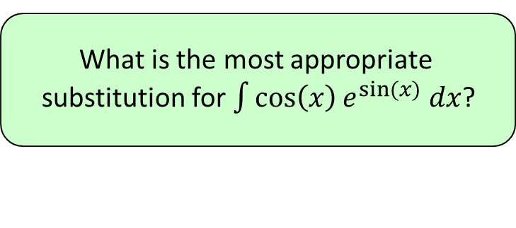
3
What is the most appropriate
substitution for $\int{\cos\left(x\right)e^{sin⁡(x)} dx}$?
a) $u=e^{\sin\left(x\right)}$
b) $u=e^{x}$
c) $u=cos⁡(x)$
d) $u=sin⁡(x)$

Slide 5
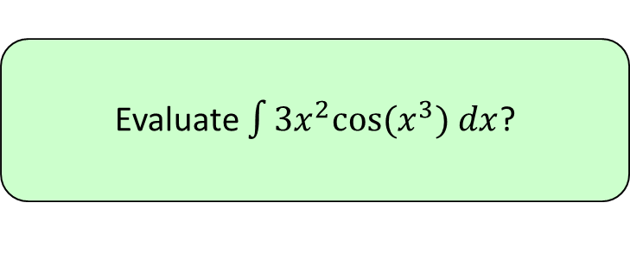
4
Evaluate $\int{3x^{2}cos⁡(x^{3}) dx}$?
a) $\sin\left(3x\right)+c$
b) ${\left(\sin\left(x\right)\right)}^{3}+c$
c) $\sin\left(x^{3}\right)+c$
d) $3\sin\left(x\right)+c$

Slide 6
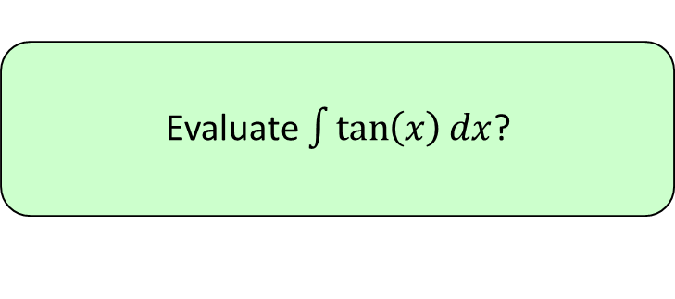
5
Evaluate $\int{\tan\left(x\right)dx}$?
a) $ln\left|cos⁡(x)\right|+c$
b) $ln\left|sin⁡(x)\right|+c$
c) $ln\left|cosec⁡(x)\right|+c$
d) $ln\left|sec⁡(x)\right|+c$

