Slide 1
Teachings for
Exercise 11E

Slide 2








Vectors
$$\vec{AB}=\vec{OB}−\vec{OA}$$
A
b - a
You need to be able to use vectors to solve geometric problems and to find the position vector of a point that divides a line segment in a given ratio
In the diagram the points A and B have position vectors a and b respectively. The point P divides line AB in the ratio 1:2. Find the position vector of P
Fill in all the information on the diagram (including vector AB)
Also indicate the ratio
1
P
2
B
a
b
O
A good start is to write the vector we want in terms of others, and then work each of those out…
$$\vec{OP}=\vec{OA}+\vec{AP}$$
Using the ratio, $\vec{AP}$ must be $\frac{1}{3}\vec{AB}$
$$\vec{OP}=\vec{OA}+\frac{1}{3}\vec{AB}$$
Replace $\vec{AB}$
$$\vec{OP}=a+\frac{1}{3}\left(b−a\right)$$
Multiply out
$$\vec{OP}=a+\frac{1}{3}b−\frac{1}{3}a$$
Simplify
$$\vec{OP}=\frac{2}{3}a+\frac{1}{3}b$$
11E

Slide 3


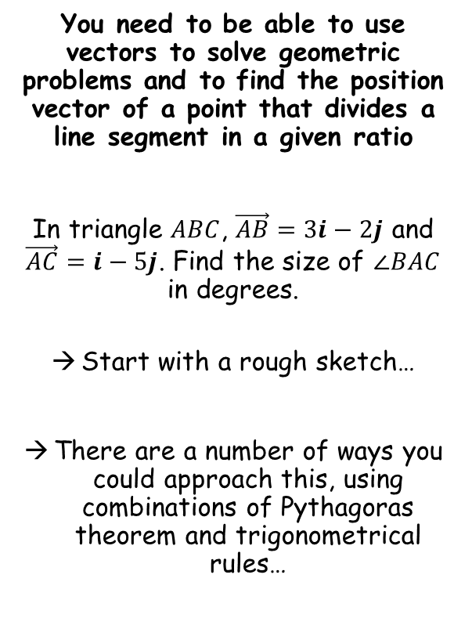






Vectors
$$\vec{AB}=\vec{OB}−\vec{OA}$$
You need to be able to use vectors to solve geometric problems and to find the position vector of a point that divides a line segment in a given ratio
In triangle $ABC$, $\vec{AB}=3i−2j$ and $\vec{AC}=i−5j$. Find the size of $∠BAC$ in degrees.
Start with a rough sketch…
There are a number of ways you could approach this, using combinations of Pythagoras theorem and trigonometrical rules…
A
$$θ$$
$$3i−2j$$
B
$$i−5j$$
$$−2i−3j$$
C
→ We can use $\vec{AB}$ and $\vec{AC}$ to find $\vec{BC}$
$$\vec{BC}=\vec{AC}−\vec{AB}$$
Sub in values
$$\vec{BC}=(i−5j)−(3i−2j)$$
Calculate
$$\vec{BC}=−2i−3j$$
11E

Slide 4


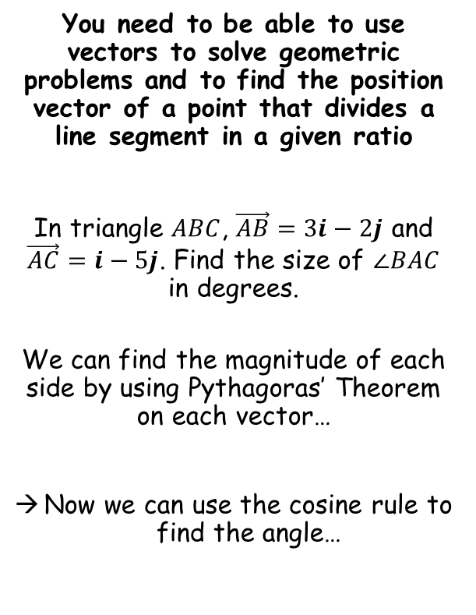





Vectors
$$\vec{AB}=\vec{OB}−\vec{OA}$$
You need to be able to use vectors to solve geometric problems and to find the position vector of a point that divides a line segment in a given ratio
In triangle $ABC$, $\vec{AB}=3i−2j$ and $\vec{AC}=i−5j$. Find the size of $∠BAC$ in degrees.
We can find the magnitude of each side by using Pythagoras’ Theorem on each vector…
Now we can use the cosine rule to find the angle…
A
c
$$\sqrt{13}$$
$$θ$$
$$3i−2j$$
B
$$\sqrt{26}$$
$$i−5j$$
b
$$\sqrt{13}$$
$$−2i−3j$$
a
C
$$a^{2}=b^{2}+c^{2}−2bcCosA$$
Sub in values
$${(\sqrt{13})}^{2}={(\sqrt{26})}^{2}+{(\sqrt{13})}^{2}−(2\sqrt{26}\sqrt{13})CosA$$
Calculate parts
$$13=39−(26\sqrt{2})CosA$$
$$\frac{\sqrt{2}}{2}=CosA$$
Rearrange
Inverse Cos
$$A={45}^{°}$$
11E

Slide 5


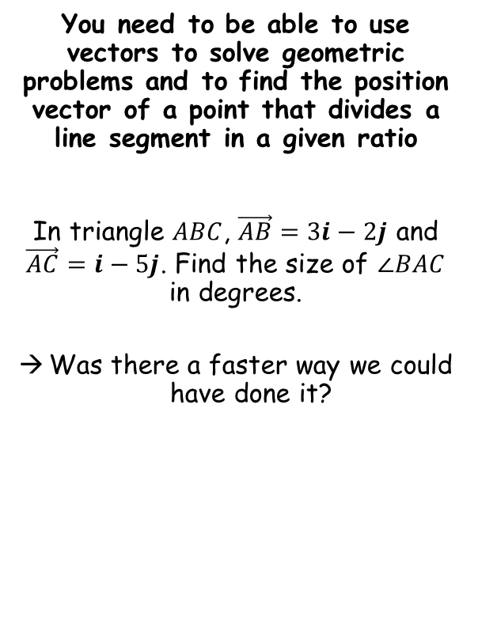


Vectors
$$\vec{AB}=\vec{OB}−\vec{OA}$$
You need to be able to use vectors to solve geometric problems and to find the position vector of a point that divides a line segment in a given ratio
In triangle $ABC$, $\vec{AB}=3i−2j$ and $\vec{AC}=i−5j$. Find the size of $∠BAC$ in degrees.
Was there a faster way we could have done it?
A
a
$$θ$$
$$\sqrt{13}$$
$$90^{°}$$
B
$$\sqrt{26}$$
c
$$\sqrt{13}$$
b
C
Lets test Pythagoras’ Theorem…
$$a^{2}+b^{2}=c^{2}$$
Sub in values
$${\left(\sqrt{13}\right)}^{2}+{\left(\sqrt{13}\right)}^{2}={\left(\sqrt{26}\right)}^{2}$$
Calculate parts
$$13+13=26$$
Since Pythagoras’ Theorem works, the triangle must be right-angled, with the longest side being the hypotenuse…
11E

Slide 6



Vectors
$$\vec{AB}=\vec{OB}−\vec{OA}$$
You need to be able to use vectors to solve geometric problems and to find the position vector of a point that divides a line segment in a given ratio
In triangle $ABC$, $\vec{AB}=3i−2j$ and $\vec{AC}=i−5j$. Find the size of $∠BAC$ in degrees.
Was there a faster way we could have done it?
A
$$θ$$
$$\sqrt{13}$$
$${45}^{°}$$
$$90^{°}$$
B
$$\sqrt{26}$$
$$\sqrt{13}$$
$${45}^{°}$$
$$θ$$
C
Also, there are 2 sides the same length, so the triangle is also isosceles!
→ This means that the other 2 angles will be equal!
Be on the lookout for patterns in questions that can help you save time!
11E

Slide 7



Vectors
$$\vec{AB}=\vec{OB}−\vec{OA}$$
$$\vec{OP}=λ(a+c)$$
c
A
B
You need to be able to use vectors to solve geometric problems and to find the position vector of a point that divides a line segment in a given ratio
OABC is a parallelogram. P is the point where OB and AC intersect.
The vectors a and c represent OA and OC respectively.
Prove that the diagonals bisect each other.
If the diagonals bisect each other, then P must be the midpoint of both AC and OB…
Try to find a way to represent OP in different ways…
(make sure you don’t ‘accidentally’ assume P is the midpoint – this is what we need to prove!)
a
P
O
C
c
One way to get from O to P
→ Start with OB
$$\vec{OB}=a+c$$
OP is parallel to OB so is a multiple of (a + c)
→ We don’t know how much for now, so can use λ (lamda) to represent the unknown quantity
$$\vec{OP}=λ(a+c)$$
11E

Slide 8





Vectors
$$\vec{AB}=\vec{OB}−\vec{OA}$$
$$\vec{OP}=λ(a+c)$$
$$\vec{OP}=a+μ(c−a)$$
A
c
B
You need to be able to use vectors to solve geometric problems and to find the position vector of a point that divides a line segment in a given ratio
OABC is a parallelogram. P is the point where OB and AC intersect.
The vectors a and c represent OA and OC respectively.
Prove that the diagonals bisect each other.
If the diagonals bisect each other, then P must be the midpoint of both AC and OB…
Try to find a way to represent OP in different ways…
(make sure you don’t ‘accidentally’ assume P is the midpoint – this is what we need to prove!)
a
P
-a
O
C
c
Another way to get from O to P
Go from O to A, then A to P
We will need AC first…
$$\vec{AC}=c−a$$
AP is parallel to AC so is a multiple of it. Use a different symbol (usually μ, ‘mew’, for this multiple)
$$\vec{AP}=μ(c−a)$$
Now we have another way to get from O to P
$$\vec{OP}=\vec{OA}+\vec{AP}$$
Sub in vectors
$$\vec{OP}=a+μ(c−a)$$
11E

Slide 9










Vectors
$$\vec{AB}=\vec{OB}−\vec{OA}$$
$$\vec{OP}=λ(a+c)$$
$$\vec{OP}=a+μ(c−a)$$
A
B
You need to be able to use vectors to solve geometric problems and to find the position vector of a point that divides a line segment in a given ratio
OABC is a parallelogram. P is the point where OB and AC intersect.
The vectors a and c represent OA and OC respectively.
Prove that the diagonals bisect each other.
If the diagonals bisect each other, then P must be the midpoint of both AC and OB…
Try to find a way to represent OP in different ways…
(make sure you don’t ‘accidentally’ assume P is the midpoint – this is what we need to prove!)
a
P
O
C
$$\vec{OP}=λ(a+c)$$
$$\vec{OP}=a+μ(c−a)$$
As these represent the same vector, the expressions must be equal!
$$λ\left(a+c\right)=a+μ(c−a)$$
Multiply out brackets
$$λa+λc=a+μc−μa$$
Factorise the ‘a’ terms on the right side
$$λa+λc=(1−μ)a+μc$$
Now compare sides – there must be the same number of ‘a’s and ‘c’s on each
$$λ=1−μ$$
$$λ=μ$$
Sub 2nd equation into the first
$$λ=1−λ$$
Rearrange and solve
So P is halfway along OB and AC and hence the lines bisect each other!
$$λ=0.5$$
$$μ=0.5$$
They are equal
11E

