Slide 1
Reverse chain rule (11.4)

Slide 2

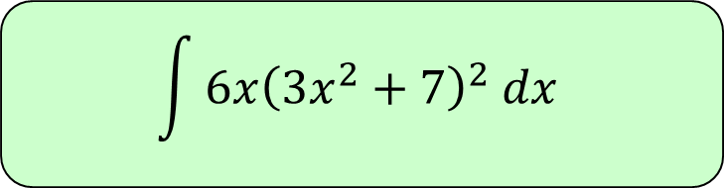

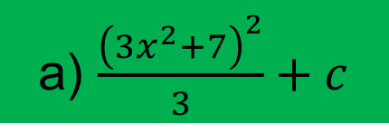
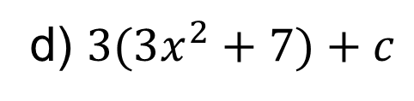
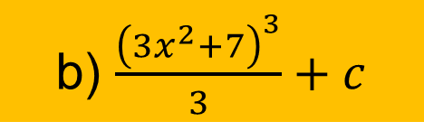
1
$$\int{{6x\left(3x^{2}+7\right)}^{2} dx}$$
a) $\frac{{\left(3x^{2}+7\right)}^{2}}{3}+c$
b) $\frac{{\left(3x^{2}+7\right)}^{3}}{3}+c$
c) ${\left(3x^{2}+7\right)}^{3}+c$
d) $3(3x^{2}+7)+c$

Slide 3
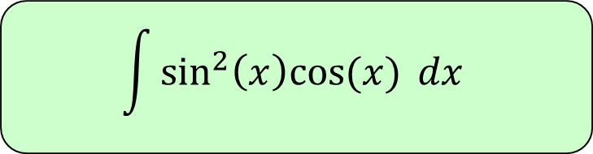
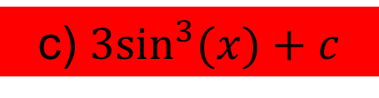

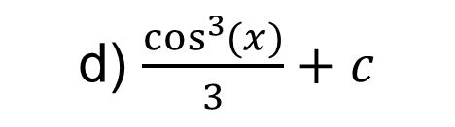
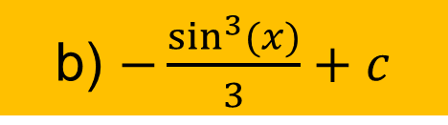
2
$$\int{\sin^{2}\left(x\right)cos⁡(x) dx}$$
a) $\frac{\sin^{3}{(x)}}{3}+c$
b) $−\frac{\sin^{3}{(x)}}{3}+c$
c) $3\sin^{3}(x)+c$
d) $\frac{\cos^{3}{(x)}}{3}+c$

Slide 4
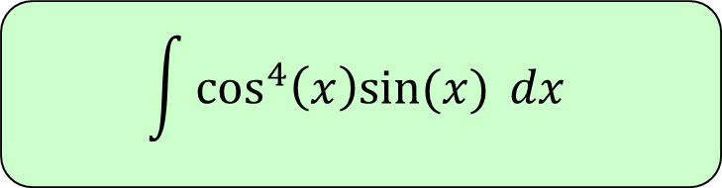
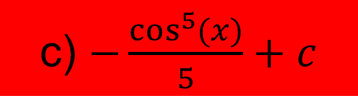

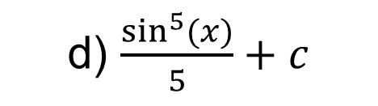

3
$$\int{\cos^{4}\left(x\right)sin⁡(x) dx}$$
a) $−\frac{\sin^{5}{(x)}}{5}+c$
b) $\frac{\cos^{5}{(x)}}{5}+c$
c) $−\frac{\cos^{5}{(x)}}{5}+c$
d) $\frac{\sin^{5}{(x)}}{5}+c$

