Slide 1
Teachings for
Exercise 11D

Slide 2
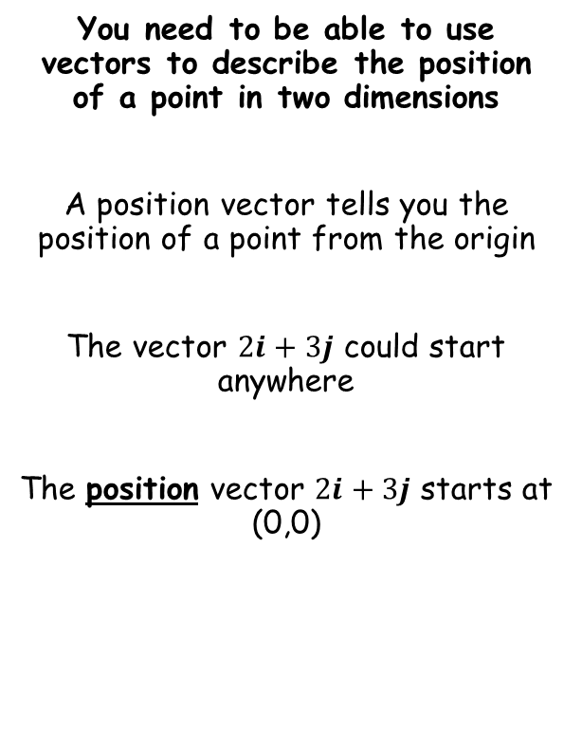
Vectors
You need to be able to use vectors to describe the position of a point in two dimensions
A position vector tells you the position of a point from the origin
The vector $2i+3j$ could start anywhere
The position vector $2i+3j$ starts at (0,0)
11D

Slide 3





Vectors
You need to be able to use vectors to describe the position of a point in two dimensions
The position vector of a point A is the vector $\vec{OA}$, where $O$ is the origin
y
y
A
A
a
B
B
b
x
x
O
O
$$\vec{AB}=−\vec{OA}+\vec{OB}$$
$$\vec{AB}=−a+b$$
$$\vec{AB}=\vec{OB}−\vec{OA}$$
$$\vec{AB}=b−a$$
11D

Slide 4



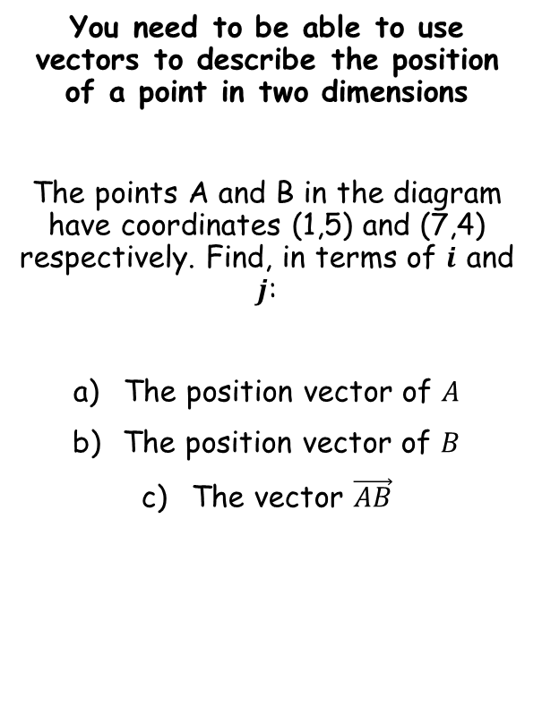





Vectors
$$\vec{AB}=\vec{OB}−\vec{OA}$$
y
You need to be able to use vectors to describe the position of a point in two dimensions
The points A and B in the diagram have coordinates (1,5) and (7,4) respectively. Find, in terms of $i$ and $j$:
The position vector of $A$
The position vector of $B$
The vector $\vec{AB}$
$$A$$
$$B$$
$$\vec{OA}=i+5j$$
O
x
$$\vec{OB}=7i+4j$$
$$\vec{AB}=\vec{OB}−\vec{OA}$$
Sub in values
$$\vec{AB}=(7i+4j)−(i+5j)$$
Simplify
$$\vec{AB}=6i−j$$
11D

Slide 5


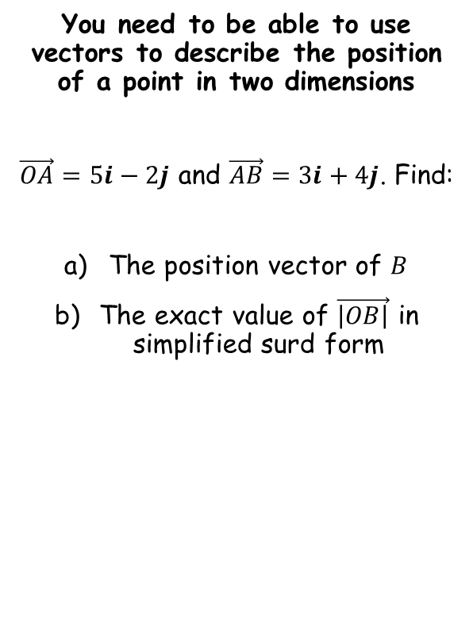





Vectors
$$\vec{AB}=\vec{OB}−\vec{OA}$$
You need to be able to use vectors to describe the position of a point in two dimensions
$\vec{OA}=5i−2j$ and $\vec{AB}=3i+4j$. Find:
The position vector of $B$
The exact value of $\vec{\left|OB\right|}$ in simplified surd form
$$\vec{AB}=\vec{OB}−\vec{OA}$$
Sub in values
$$3i+4j=\vec{OB}−(5i−2j)$$
Be very careful with the negatives here!
$$3i+4j=\vec{OB}−5i+2j$$
Rearrange
$$8i+2j=\vec{OB}$$
$$\vec{\left|OB\right|}=\sqrt{{(8)}^{2}+{(2)}^{2}}$$
Calculate
$$\vec{\left|OB\right|}=\sqrt{68}$$
Simplify
$$\vec{\left|OB\right|}=2\sqrt{17}$$
11D

