Slide 1
Using trigonometric identities (11.3)

Slide 2
Simplify the integral!
You must use your knowledge of trigonometric identities to simplify the integral into something that you know how to integrate.

Slide 3
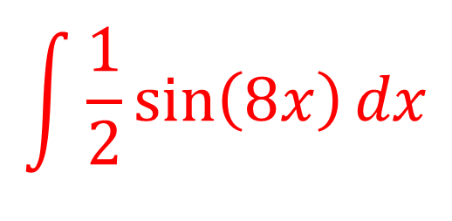
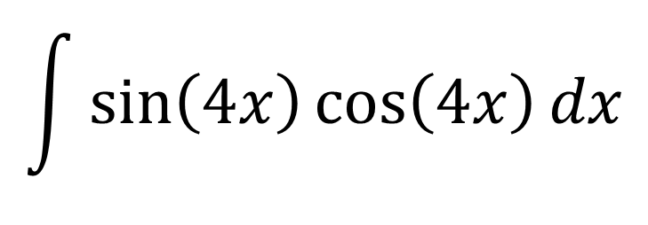
$$\int{\sin\left(4x\right)\cos\left(4x\right)dx}$$
$$\int{\frac{1}{2}\sin\left(8x\right)dx}$$

Slide 4
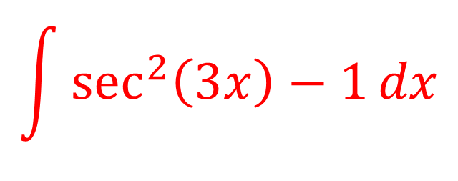
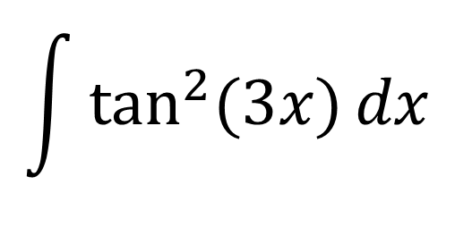
$$\int{\tan^{2}{(3x)}dx}$$
$$\int{\sec^{2}\left(3x\right)−1dx}$$

Slide 5
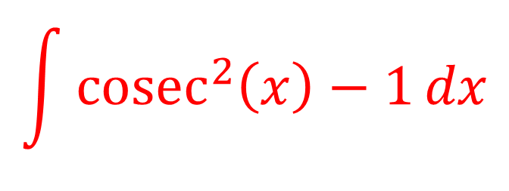
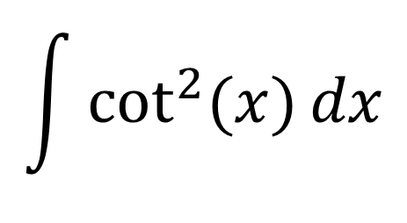
$$\int{\cot^{2}{(x)}dx}$$
$$\int{{cosec}^{2}\left(x\right)−1dx}$$

Slide 6
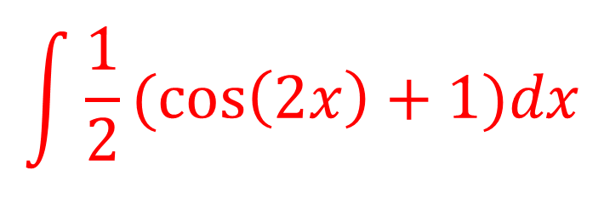
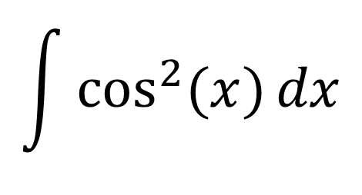
$$\int{\cos^{2}{(x)}dx}$$
$$\int{\frac{1}{2}(\cos\left(2x\right)+1)dx}$$

Slide 7
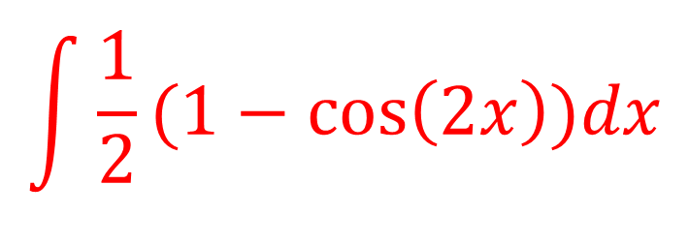
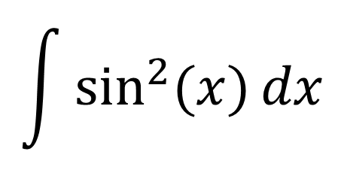
$$\int{\sin^{2}{(x)}dx}$$
$$\int{\frac{1}{2}(1−\cos\left(2x\right))dx}$$

Slide 8
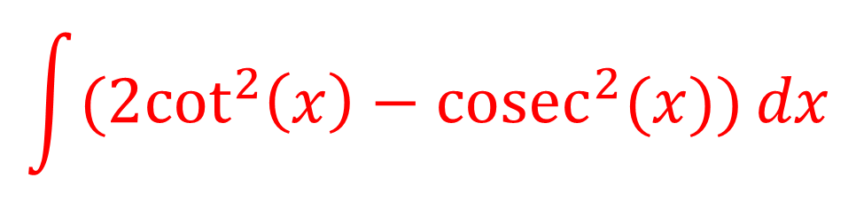
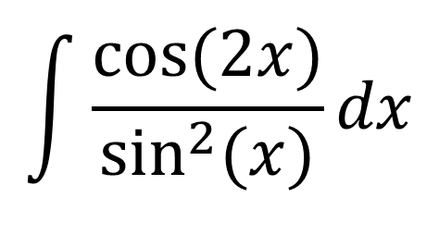
$$\int{\frac{cos⁡(2x)}{\sin^{2}{(x)}}dx}$$
$$\int{({2cot}^{2}\left(x\right)−cosec^{2}(x))dx}$$

