Slide 1

Integrating $f(ax+b)$(11.2)

Slide 2
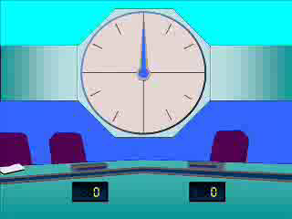





1
$$\int{e^{5x} dx}$$
a) $5e^{4x}+c$
b) $\frac{e^{6x}}{6x}+c$
c) $\frac{e^{5x}}{5}+c$
d) $\frac{e^{6x}}{6}+c$

Slide 3


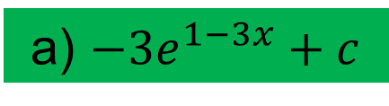
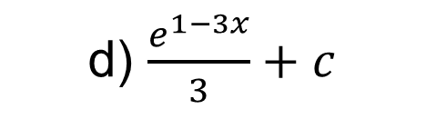

2
$$\int{e^{1−3x} dx}$$
a) $−3e^{1−3x}+c$
b) $\frac{e^{2−3x}}{2−3x}+c$
c) $−\frac{e^{1−3x}}{3}+c$
d) $\frac{e^{1−3x}}{3}+c$

Slide 4


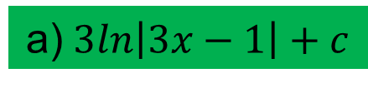
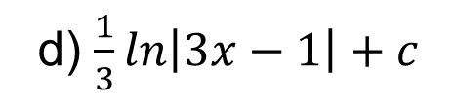

3
$$\int{\frac{1}{3x−1} dx}$$
a)$3ln\left|3x−1\right|+c$
b)$3ln\left|x\right|+c$
c) $\frac{1}{3}ln\left|x\right|+c$
d) $\frac{1}{3}ln\left|3x−1\right|+c$

Slide 5
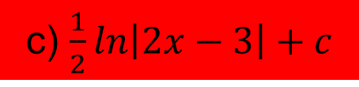
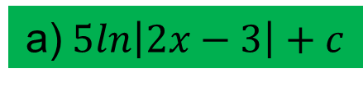

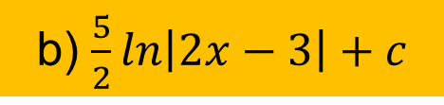
4
$$\int{\frac{1}{3x−1} dx}$$
a)$5ln\left|2x−3\right|+c$
b) $\frac{5}{2}ln\left|2x−3\right|+c$
c) $\frac{1}{2}ln\left|2x−3\right|+c$
d) $\frac{2}{5}ln\left|3x−1\right|+c$

Slide 6

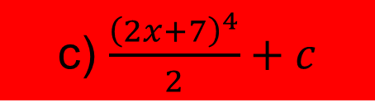
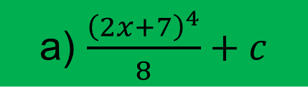
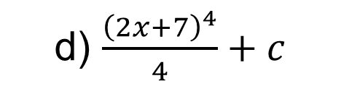
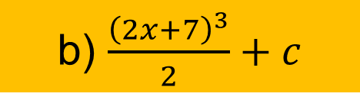
5
$$\int{{\left(2x+7\right)}^{3} dx}$$
a) $\frac{{\left(2x+7\right)}^{4}}{8}+c$
b) $\frac{{\left(2x+7\right)}^{3}}{2}+c$
c) $\frac{{\left(2x+7\right)}^{4}}{2}+c$
d) $\frac{{\left(2x+7\right)}^{4}}{4}+c$

Slide 7

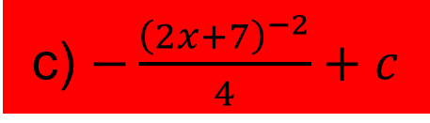
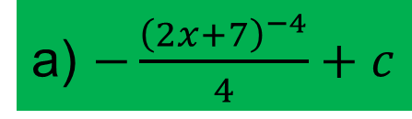
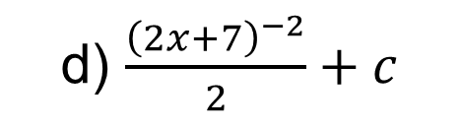
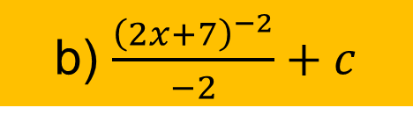
6
$$\int{{\left(3x−5\right)}^{−3} dx}$$
a) $−\frac{{\left(2x+7\right)}^{−4}}{4}+c$
b) $\frac{{\left(2x+7\right)}^{−2}}{−2}+c$
c) $−\frac{{\left(2x+7\right)}^{−2}}{4}+c$
d) $\frac{{\left(2x+7\right)}^{−2}}{2}+c$

Slide 8
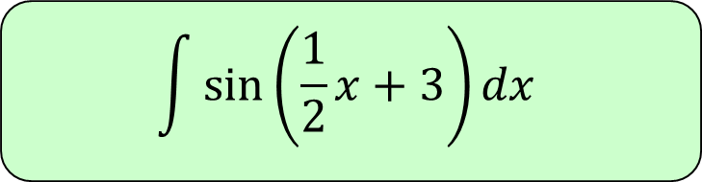




7
$$\int{\sin\left(\frac{1}{2}x+3\right)dx}$$
a) $−\frac{1}{2}sin\left(\frac{1}{2}x+3\right)+c$
b) $−2cos\left(\frac{1}{2}x\right)+c$
c) $−2cos\left(\frac{1}{2}x+3\right)+c$
d) $−\frac{1}{2}cos\left(\frac{1}{2}x+3\right)+c$

Slide 9
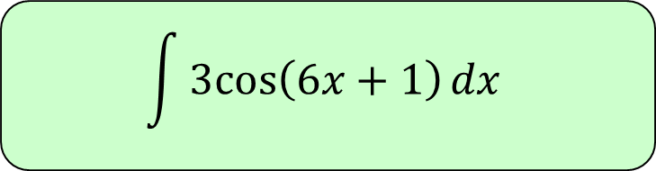




8
$$\int{3cos\left(6x+1\right)dx}$$
a) $\frac{1}{6}sin\left(6x+1\right)+c$
b) $\frac{1}{2}sin\left(6x+1\right)+c$
c) $18sin\left(6x+1\right)+c$
d) $\frac{1}{2}cos\left(6x+1\right)+c$

Slide 10





9
$$\int{\sec^{2}{(2x)}dx}$$
a) $\frac{1}{2}tan⁡(2x)+c$
b) $sin\left(2x\right)+c$
c) $\frac{1}{2}tan⁡(x)+c$
d) $\tan^{2}{(2x)}+c$

