Slide 1
Vectors
Twitter: @Owen134866
www.mathsfreeresourcelibrary.com

Slide 2
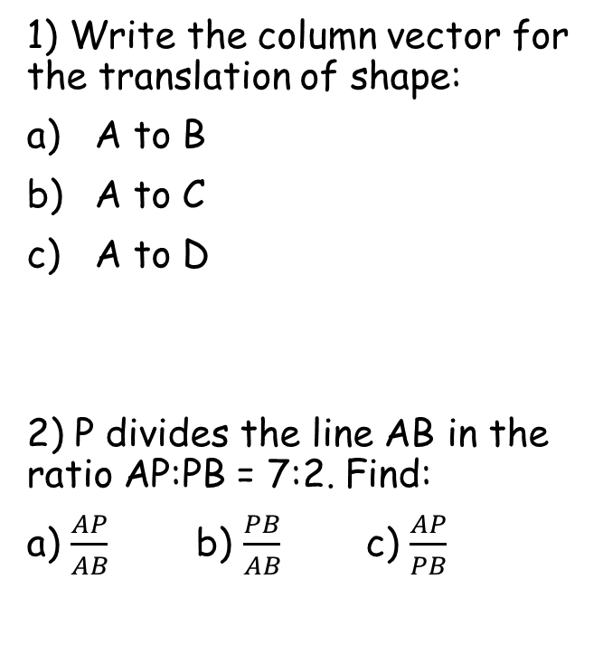
Prior Knowledge Check
1) Write the column vector for the translation of shape:
A to B
A to C
A to D
2) P divides the line AB in the ratio AP:PB = 7:2. Find:
a) $\frac{AP}{AB}$ b) $\frac{PB}{AB}$ c) $\frac{AP}{PB}$
3) In each triangle, find $x$ to one decimal place
$$\left(\begin{matrix}4 \\ 2\end{matrix}\right)$$
$$123.2$$
$$\left(\begin{matrix}5 \\ −2\end{matrix}\right)$$
B
3
x
13
A
7
$$\left(\begin{matrix}−1 \\ −3\end{matrix}\right)$$
70
30
C
9
x
$$13.6$$
D
8
7
40
110
5
x
x
18
$$\frac{7}{9}$$
$$\frac{2}{9}$$
$$\frac{7}{2}$$
$$5.3$$
$$21.4$$

Slide 3
Teachings for
Exercise 11A

Slide 4
Vectors
A vector has both magnitude and direction. You can represent a vector using a directed line segment.
A vector can be represented as a directed line segment
Two vectors are equal if they have the same magnitude and direction
Two vectors are parallel if they have the same direction
You can add vectors using the triangle law of addition
a
3a
A
C
B
$$AC=AB+BC$$
11A

Slide 5
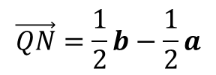
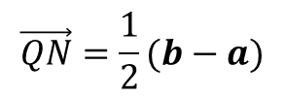
Vectors
A vector has both magnitude and direction. You can represent a vector using a directed line segment.
A
Q
C
OACB is a parallelogram. The points P, Q, M and N are the midpoints of the sides.
OA = a
OB = b
Express the following in terms of a and b.
a) OC b) AB c) QC
d) CN e) QN
a
D
N
M
P
O
b
B
What can you deduce about AB and QN, looking at the vectors?
a + b
b - a
¹/₂b
$$\vec{AB}=b−a$$
$$\vec{QN}=\frac{1}{2}b−\frac{1}{2}a$$
QN is a multiple of AB, so they are parallel!
$$\vec{QN}=\frac{1}{2}(b−a)$$
-¹/₂a
¹/₂b - ¹/₂a
11A

Slide 6
Vectors
$$\vec{AN}=\frac{1}{3}\vec{AB}$$
A vector has both magnitude and direction. You can represent a vector using a directed line segment.
A
$$\vec{OA}=2a$$
a
1
N
M
In triangle OAB, M is the midpoint of OA and N divides AB in the ratio 1:2.
OM = a
OB = b
Express ON in terms of a and b
a
2
O
b
B
Use the ratio. If N divides AB in the ratio 1:2, show this on the diagram
You can see now that AN is one-third of AB
We therefore need to know AB
To get from A to B, use AO + OB
$$\vec{ON}=\vec{OA}+\vec{AN}$$
$$\vec{ON}=2a+−\frac{2}{3}a+\frac{1}{3}b$$
Sub in values
$$\vec{AB}=\vec{AO}+\vec{OB}$$
Simplify
Sub in AO and OB
$$\vec{ON}=\frac{4}{3}a+\frac{1}{3}b$$
$$\vec{AB}=−2a+b$$
$$\vec{AN}=−\frac{2}{3}a+\frac{1}{3}b$$
AN = ¹/₃AB
11A

