Slide 1
Integrating standard functions (11.1)

Slide 2
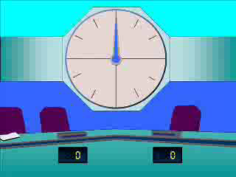
1
$$\int{2sin\left(x\right)dx}$$
a) $2\cos\left(x\right)+c$
b) $−2cos\left(x\right)+c$
c) $−\frac{1}{2}\cos\left(x\right)+c$
d) $−\cos\left(\frac{1}{2}x\right)+c$

Slide 3
2
$$\int{\sin\left(3x\right)dx}$$
a) $−cos\left(3x\right)+c$
b) $3\cos\left(3x\right)+c$
c) $−\frac{1}{3}\cos\left(3x\right)+c$
d) $\frac{1}{3}\cos\left(3x\right)+c$

Slide 4
3
$$\int{cosec\left(x\right)cot⁡(x) dx}$$
a) $−cosec\left(x\right)+c$
b) $\operatorname{cosec}\left(x\right)+c$
c) $tan⁡(x)+c$
d) ?

Slide 5
4
$$\int{{cosec}^{2}\left(x\right) dx}$$
a) $−tan(x)+c$
b) $−cot⁡(x)+c$
c) $tan⁡(x)+c$
d) $\cot\left(x\right)+c$

Slide 6
5
$$\int{\frac{cos⁡(x)}{\sin^{2}{(x)}}dx}$$
a) $−cosec\left(x\right)+c$
b) $cosec⁡(x)+c$
c) $cot⁡(x)+c$
d) $−cot\left(x\right)+c$

Slide 7
6
$$\int{x+\sec^{2}{(x)}dx}$$
a) $\frac{x^{2}}{2}+tan⁡(x)+c$
b) $x^{2}+tan⁡(x)+c$
c) $\frac{x^{2}}{2}+\sec^{2}⁡(x)+c$
d) $\tan\left(x\right)+c$

